Slide 1
Colchester Public Schools Student Success Plans Planning for success for all students
Prepared by:
Linda Iacobellis, BA Assistant Principal
Ronald Sefchik, BA School Counselor
Jeffry Mathieu, BA Principal
Barbara Gilbert, Colchester Director of Curriculum

Slide 2
Objectives for Student Success Plans
Create elements of the SSP, beginning in grade 6, to prepare a rigorous, individualized program for every student
Ensure every high school student has an electronic & portable SSP to address individual needs, aspirations, and career goals
Make high school students aware of the Connecticut Career Pathways Initiative and select an appropriate pathway as the foundation of the SSP

Slide 3
Core Components of Effective SSPs*
Academic Development:
Acquiring skills, knowledge, attitudes to be effective learner and for life
Career Development:
Acquiring skills needed to investigate world of work and achieve future career success
Personal/Social Development:
Developing an understanding of and respect for self and others
Understanding the necessary steps for decision-making and goal attainment
Acquiring safety and survival skills
* from CSDE School Counselor Standards

Slide 4
Student Success Plans: The Key to Student Engagement
An individualized student-driven success plan will:
Help every student stay connected in school
Help students achieve post-secondary education and career goals
Begin in 6th grade and continue through high school and beyond
Provide student support in setting goals for personal and academic growth
Aid students in exploring education, interests and career paths
Provide a vehicle for integration and demonstration of 21st century skills & professional skills
Our plan will:
Utilize an electronic system for efficiency and portability
Engage adults in the support and guidance of students

Slide 5
Timeline
On July 1, 2012, a SSP will be implemented for each student in grades 6-12
Beginning 2012-13, every sixth grader will have an electronic SSP on Naviance
Beginning 2012-13, all students grades 6-12 will complete the SSP components of their grade
Beginning with the class of 2016, students will choose an academic focus area

Slide 6
16 Academic Focus Areas
CT Career Pathways 16 Career Clusters
CT Career Pathways Wheel to illustrate the Bacon Academy Focus Areas - linked to pathway options and course requirements
Indicate on transcript completion of Focus Area (*) and achievement of Distinction (**)

Slide 7
Bacon Academy Mission Statement
Academic Expectations
Communicate in a variety of methods
Read, analyze and evaluate information from multiple sources
Use problem-solving skills across the disciplines
Use technology as a tool for learning, creating, organizing, and presenting

Slide 8
Bacon Academy Mission Statement
Social and Civic Expectations
Demonstrate the five core values:
Respect
Responsibility
Achievement
Safety
Compassion

Slide 9
BA
Mission

Slide 10
How BA School Counselors Aid Students with Success Plans
Freshmen counselor provides overview of opportunities at BA to grade 7 students/discusses course offerings to grade 8 students
Developmental guidance lessons in the classroom at each grade level
Curriculum Night
Freshmen Orientation in August
College Career Pathways opportunities
Individual planning meetings with students
College Knowledge Night
Post-secondary fair for juniors and seniors
Senior planning night
College tours with Youth Services
Job shadowing arrangements
Peer mediation
ECE and AP Courses
PSAT, SAT, ACT, ASVAB testing

Slide 11
Student Responsibilities
Utilize electronic tools in Naviance
Interest inventories, completed grades 9-12
Family connection
Track Task Completion on Task bar
Resume building
College/career exploration
College applications (e-docs)
Utilize electronic tools in Power School
Course selection
Monitor academic progress and strive to achieve
Graduation requirement tracker
Attend events organized by school counseling department
Be an active participant in planning for the future

Slide 12
Grade 9 SSP Survey on Naviance
Career interests
Academic strengths & weaknesses
Transition to high school
Adult support
Social connections/friends
Academic interests
Academic goals
Study habits
Organization of academic responsibilities
Interest in school/learning
Interests beyond high school and connection to focus area
Participation in extracurricular activities

Slide 13
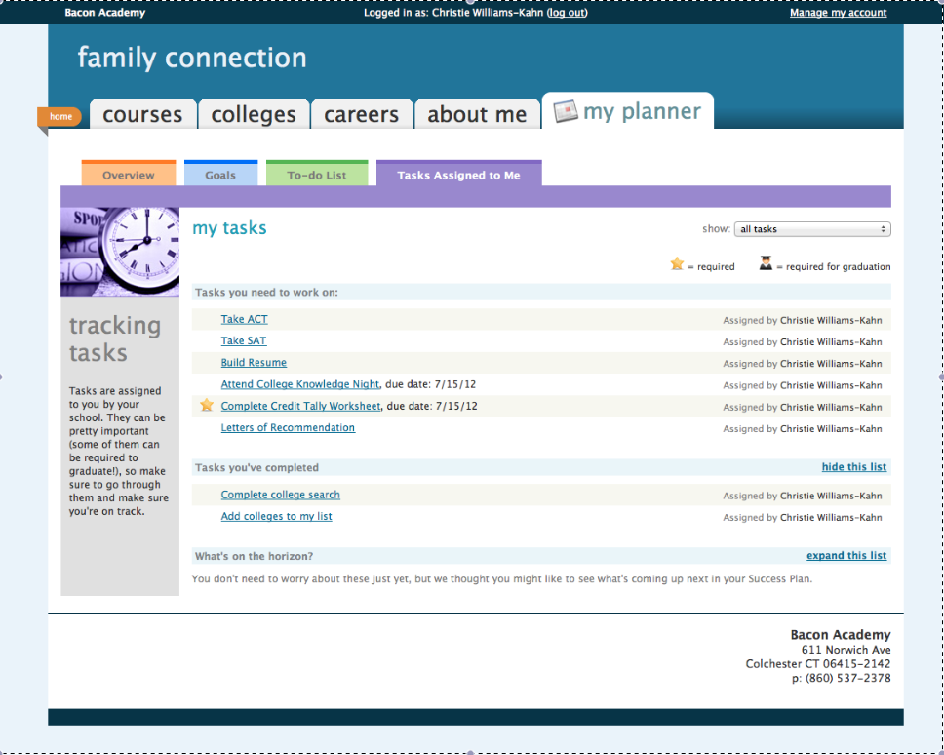

Slide 14
SSP at Bacon Academy
Grade 9:
4-Year academic planning and goal-setting
Study skills
Checklist survey (Colchester created)
Begin creating resume
Civic & social expectations
Career interest profiler
Core values instruction
Complete grade 9 tasks in Naviance
Commit to focus area
Grade 10:
Update 4-Year academic plan
Do What You Are (personality inventory)
Grade 10 survey
Follow-up of DWYA
Continue resume building
Review civic & social expectations
Tie in with academic class (social studies)
Complete grade 10 tasks in Naviance
Reflect on focus area

Slide 15
Grade 11
Update 4-yr academic plan and continue to fulfill requirements for focus area
Update academic and career goals
Update resume
Review core values and civic and social expectations in light of personal decision-making
Complete grade 11 survey
Participate in post-secondary planning meeting with school counselor
Complete grade 11 tasks in Naviance
Participate in job shadowing activities, where available
College and career planning lesson
Complete “My Game Plan”
Create list of colleges of interest in Naviance

Slide 16
Grade 12
Update 4-yr academic plan and continue to fulfill requirements for focus area
Complete grade 12 tasks in Naviance
Review academic and career goals
Update resume and use e-docs for college application documents (checklist)
Complete grade 12 survey
Explore scholarship opportunities
Review core values and civic and social expectations in light of personal decision-making
Complete post-secondary planning survey
Continue to meet with your school counselor to review your SSP
Participate in job shadow/internship opportunities
Complete exit survey

Slide 17
Who’s doing the work?
Planning
Implementation

Slide 18
Planning
Team approach - Superintendent, Director of Curriculum, Principal, Assistant Principals, School Counselors, Teachers
Create BA’s SSP vision - Superintendent, Director of Curriculum, Principal, Assistant Principal & Grade 9 School Counselor
Align courses with focus areas
Share focus area course selections with teachers
Meet with school counselors regarding implementation
Presentation to the BOE for review/approval

Slide 19
Implementation
Vision:
Whole-school approach
Students – plan and reflect on their individual progress
School Counselors – oversee student progress
Faculty & Admin. – focus area committees with cohorts of students

Slide 20
Homeroom/Advisories
Structure:
Students assigned to homerooms by grade
Students divided into groups of 10-12
All staff serve as homeroom mentors
Homerooms meet twice a month for 25 minutes

Slide 21
Homerooms/Advisories
Purpose:
To ensure every student is connected to an adult at school
Grade-based curriculum
Delivery of whole-school lesson plans

Slide 22
Questions and Comments

