Slide 1


Slide 2
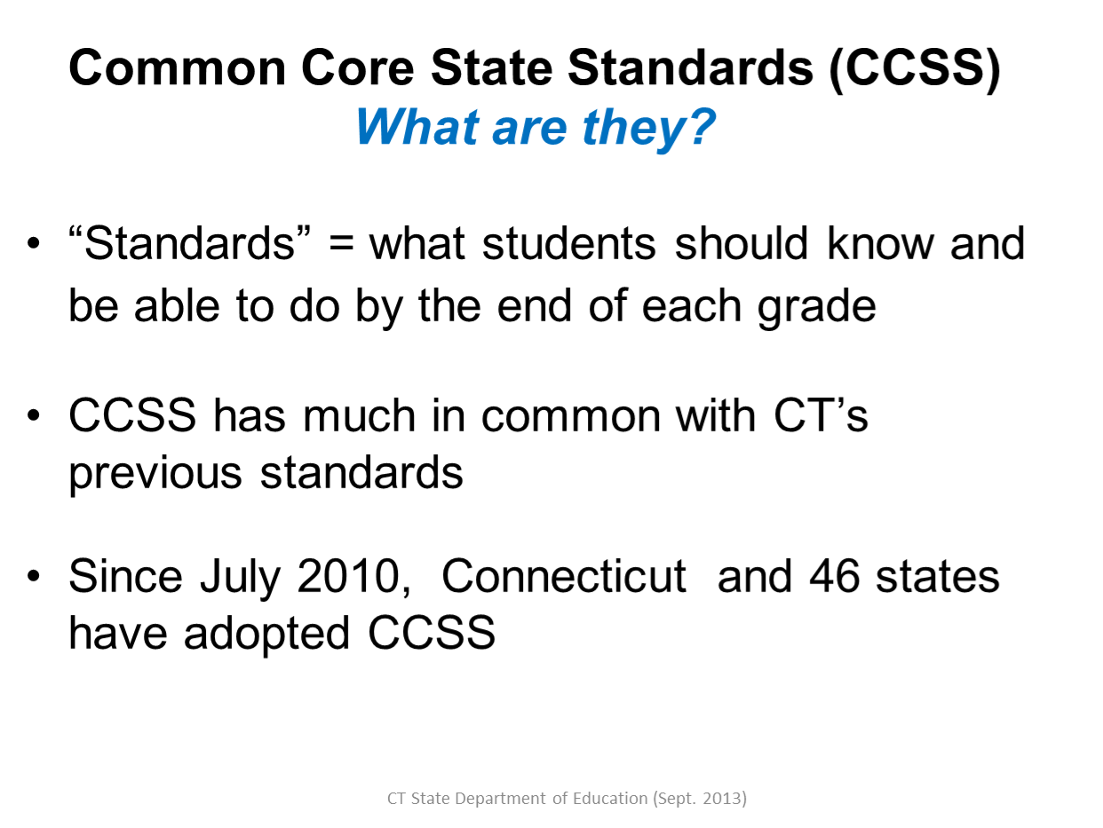

Slide 3
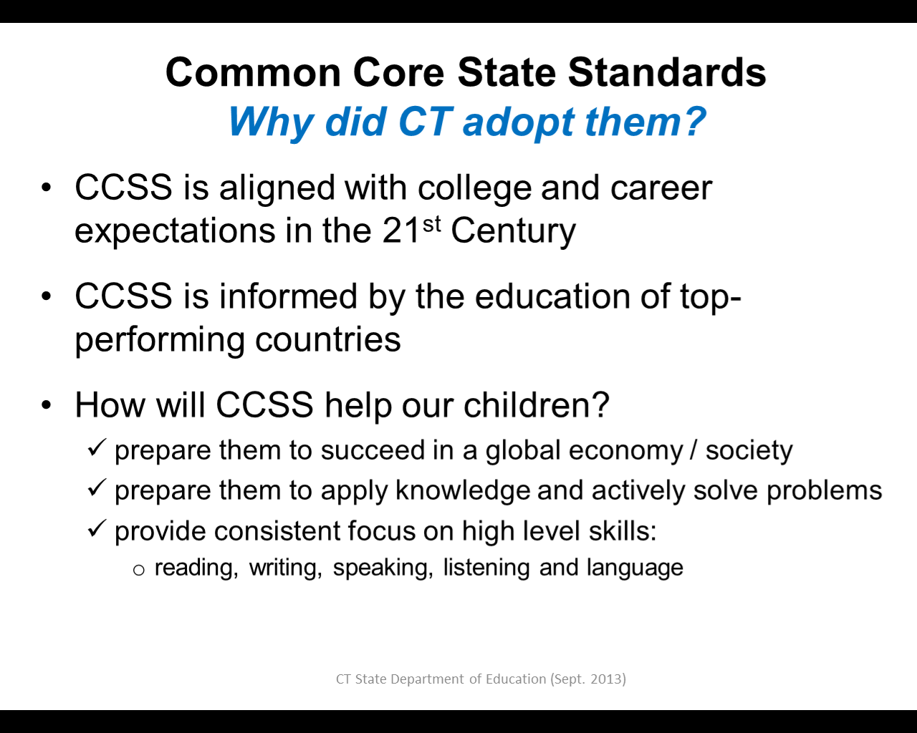

Slide 4
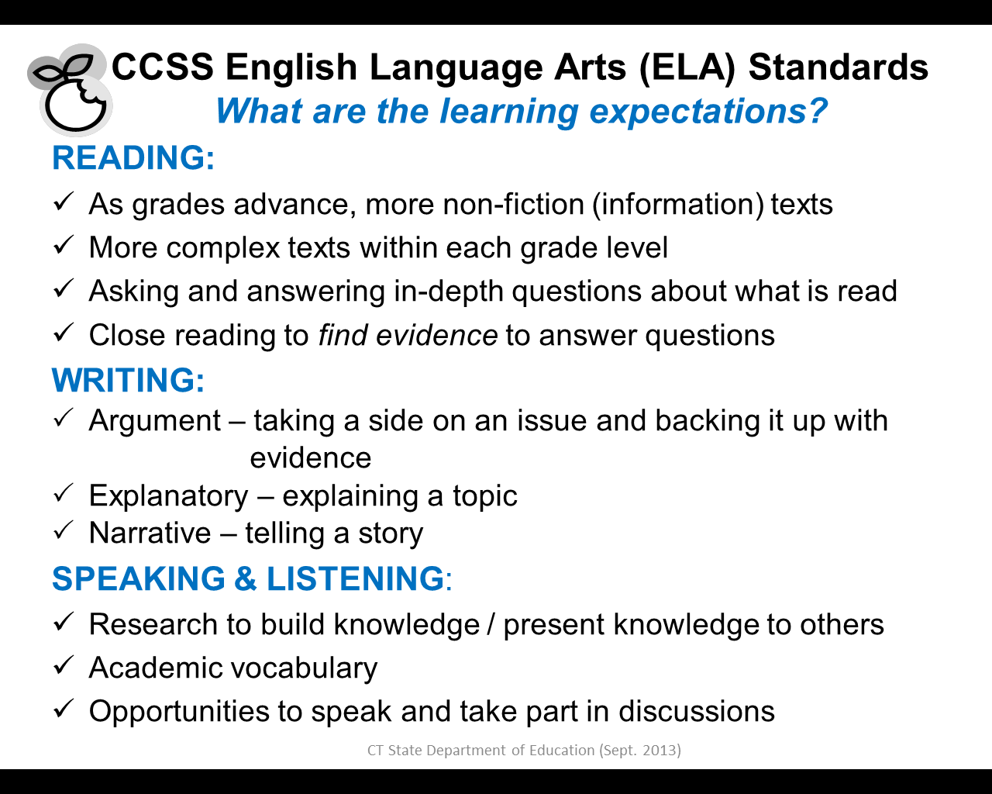

Slide 5
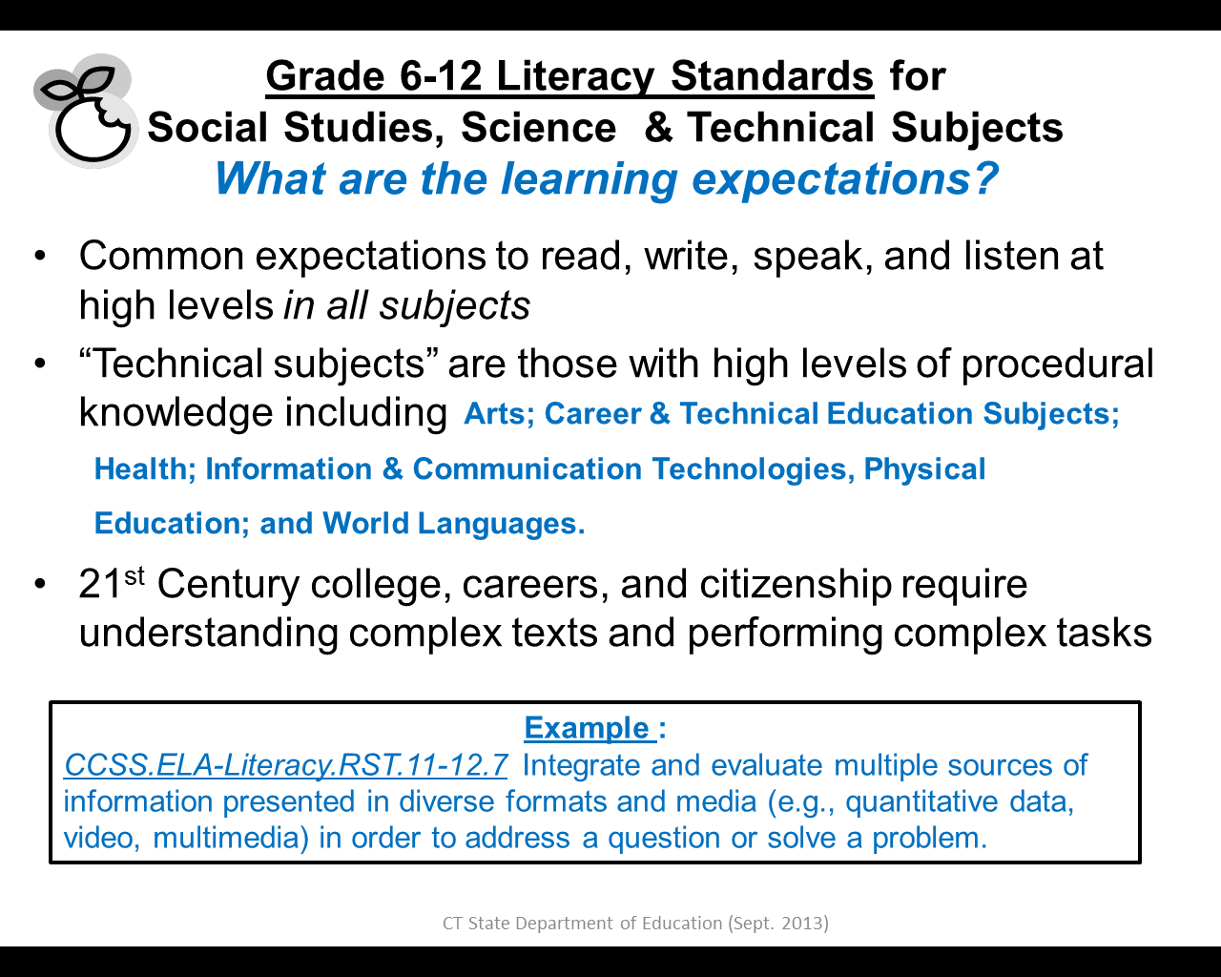

Slide 6
CCSS Mathematics Standards
What are the learning expectations?
Grade K- 8 Math Content Standards
  Build deep understanding, not just procedural skill
  Develop fluency (speed and comfort) in computation, measurement, and ratios and proportional reasoning.
  Apply math understanding by solving real world problems and actively discussing solutions.
Grade 9-12 Math Content Standards
Emphasize the use of mathematics and statistics to analyze problems, understand them better, and improve decisions.
Apply mathematics to novel situations with multiple solutions, as college students and employees regularly do.

Slide 7
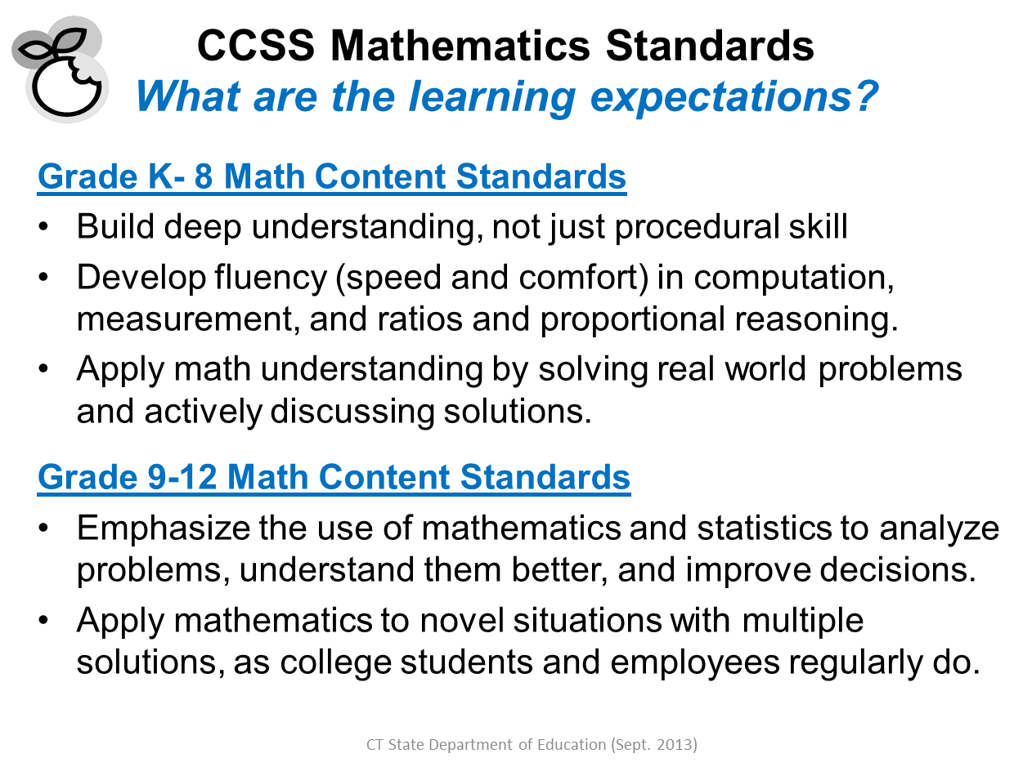

Slide 8
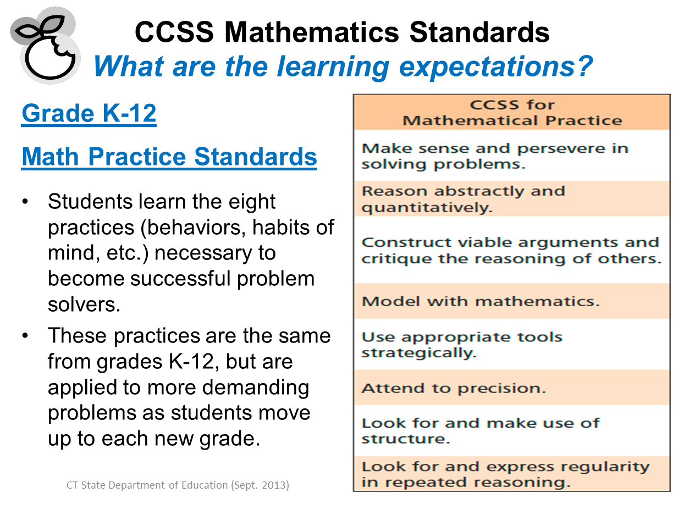

Slide 9
School or District CCSS Highlights
What every parent should know
(Add district or school implementation steps here)
Notes:
District

Slide 10


Slide 11
