Slide 1
Student Success Plans Planning for success for all students
Pamela Sordi, Director of School Counseling
Nonnewaug High School
Region 14

Slide 2
“For the school year commencing July 1, 2012, and each school year thereafter, each local and regional board of education shall create a student success plan for each student enrolled in a public school , beginning in grade six. Such student success plan shall include a student’s career and academic choices in grades six to twelve, inclusive.”

Slide 3
What is a Student Success Plan?
Purpose
Components
Development

Slide 4
The Mission
To prepare
EVERY student
for learning, life,
and work
in the 21st century.
Notes:
This is the defining challenge of our times in public school.

Slide 5
Objectives for Student Success Plans
Prepares students for:
□ postsecondary education, life, and careers
□ competition in a dynamic global economy
Provides students:
□ opportunity to design their own future with the support of critical adults and innovative school policies
□ opportunity to know and understand self in a positive learning environment

Slide 6
Components of Student Success Plans
21st Century Skills
Critical Thinking
Problem Solving
Innovation
Creativity
Self-Direction
Work Ethic
Collaboration
Written Communication
Information Technology
Leadership
21st Century Skills Professional Skills
Pathways
Professional Skills
Interpersonal
Work & Personal
Ethics
Communication
Attendance
Interview Abilities
Attitude
Teamwork
Time Management
Organizational Leadership
Cultural Awareness
ELA/
Reading
History/
Social Studies
Mathematics
CT’s Comprehensive School Counseling Curriculum
World
Language
Science
Physical
Education
Arts
Pathways
Foundation: Rigorous academic courses and a related sequence of elective courses
aligned to a specific career pathway in providing:
Experiential Learning: Job Shadows, Internships, Community Service
Dual/Concurrent Credit
Capstone Project
21st Century and Professional Skills across-the-curriculum
Evolving post-secondary plan
June Sanford
11/19/2007

Slide 7
Key to Student Engagement
An individualized flexible student-driven plan
Helps every student stay connected in school
Helps students achieve post-secondary education and career goals
Begins in 6th grade and continues through high school and beyond
Establishes an adult support team which may include teachers, counselors, school psychologists, social workers, parents/guardians, community members, etc.
Provides student support in setting goals for personal and academic growth
Explores education, interests and career paths
Provides a vehicle for integration and demonstration of 21st century skills
Utilizes an electronic system for efficiency and portability (when possible)

Slide 8
Required Areas of Development
Academic Development
Career Development
Social, Emotional & Personal Development

Slide 9
Academic Development
Acquiring skills, knowledge, attitudes to be effective learner and for life
Specific Model Criteria:
Rigorous courses linked to interests, skills and career pathways
Courses for the attainment of Education and/or Career goals
Successful completion of Portfolio/Capstone Project
Support & Assessment of Student Progress with Mentor/Advisor
Timely Intervention and Student Support
Learning experiences outside of the classroom

Slide 10
Career Development
Acquiring skills needed to investigate world of work and achieve future career success
Specific Model Criteria:
□ Interest and ability inventories
□ Career exploration and interest courses
□ Post Secondary Education and Career Pathway Development
□ Experiential Learning (i.e., work-based learning, community service, capstone project)

Slide 11
Social, Emotional & Physical Development
Developing an understanding of and respect for self and others
Understanding the necessary steps for decision-making and goal attainment
Acquiring safety and survival skills
Specific Model Criteria:
Empathetic Interactions and Community Service
Self Regulation and Resiliency
Healthy and Safe Life Skills/Choices
Broadened Awareness of Self within a Global Context
Identification of School and Community Resources

Slide 12
What do we already do?
How will we do it?
What do we want to do?
How do we begin?

Slide 13
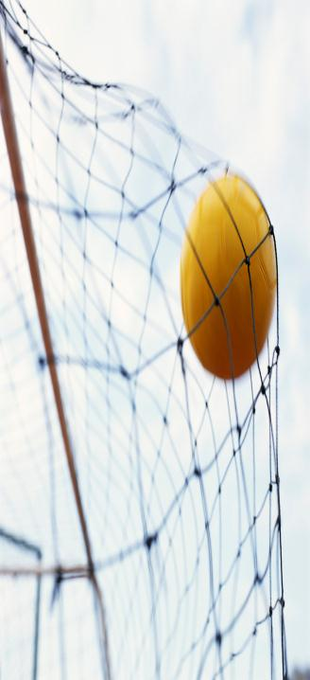
How it all comes together
Attend Professional Development– Become familiar with specifics of SSP’s
Establish SSP team – Create a team to guide SSP development in your school
Talk to those who have established SSP’s– Learn what others do and use what works for your students and your schools
Identify supporting technology– define systems that will align with your SSP’s to support SSP components and provide documentation
Review current programs and state guidelines – identify components already in place, revise if necessary, and add to areas identified as gaps
Identify how, when and by who - SSP’s will be developed for each student in your school

Slide 14
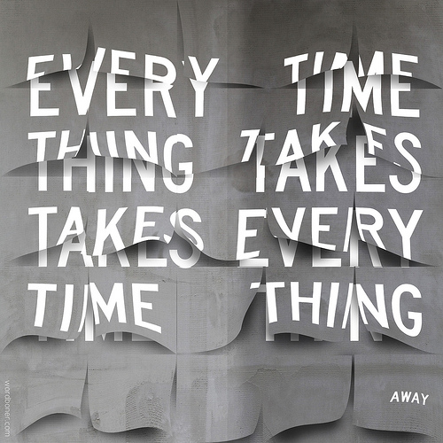
SSP development will evolve
Implementation– Implement SSP’s 6-12. Remember students individualize and drive their own plan
Collaboration– Who will be involved; teachers (through advisory, classroom, etc.) How are parents involved?
Review, Analyze and Revise – Continued meetings with SSP team
Evaluate -SSP & make changes
Hold annual district meetings -to ensure systemic SSP development

Slide 15
What the SSP is not
SSP
The sole responsibility of school counselors
SSPs are only necessary for students who are not meeting age and/or grade level expectations
An electronic system
A plan to begin in grade 6 with a gradual role out
A plan that tracks students into a career path beginning in gr. 6
An inflexible career track
A plan that requires an electronic system
©Rinaldi, Ellington High School

Slide 16
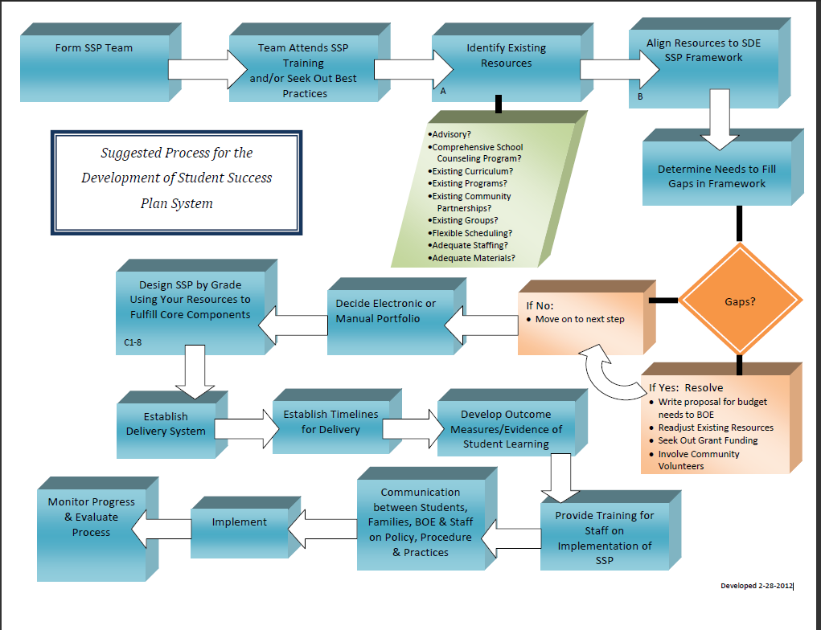
CT State Dept. of Education

Slide 17
The Middle School SSP Survey
SSP Sample Components
1. An ACADEMIC goal I have for 6th grade is:
2. A PERSONAL or SOCIAL goal I have for 6th grade is:
3. Five words that describe who I am today are:
4. My strengths are:
5. I need to improve:
6. Which one most accurately describes my plans for after high school at this time?
(Drop down menu choices: 4 yr. college, 2 yr. college, Military, Employment, Other)
7. My dream career is:
8. When I'm not in school, I like to: (include hobbies, sports, clubs, etc.)
9. My Awards, Honors, and Activities:
10. If I could have just one wish granted, I would wish for... because...
11. A person I admire is:
12. If I could live any place in the world I would choose... because...
13. If I could do anything to "Be the change I wish to see in the world", I would:

Slide 18
Student Success Plan – Grade 6
Guaranteed experiences that incorporate 21st Century Skills into the academic (A), personal/social (P/S), and career (C) domains
Grade 6 SSP Survey (Academic Questions)
Setting & Updating S.M.A.R.T. Goals (Advisory)
Transition Planning for Middle School (Multiple Intelligence Survey)
Career Key Interest Inventory
Career Exploration & “My Favorites” List
Grade 6 SSP Survey (Social & Emotional Questions)
Activity Resume (Advisory)
School Satisfaction Survey

Slide 19
Student Success Plan – Grade 7
Guaranteed experiences that incorporate 21st Century Skills into the academic (A), personal/social (P/S), and career (C) domains
Grade 7 SSP Survey (Academic Questions - Naviance)
Setting & Updating S.M.A.R.T. Goals (Advisory)
My Personal Inventory (Naviance)Career Development
Continue Career Exploration & “My Favorites” List (Naviance) Social, Emotional, & Physical Development
Grade 7 SSP Survey (Social & Emotional Questions - Naviance)
Update Activity Resume (Advisory)
School Satisfaction Survey (Naviance)

Slide 20
Student Success Plan – Grade 8
Guaranteed experiences that incorporate 21st Century Skills into the academic (A), personal/social (P/S), and career (C) domains
Grade 8 SSP Survey (Academic Questions)
Setting & Updating S.M.A.R.T. Goals
Transition Planning for High School
Career Clusters Inventory
Career Exploration & “My Favorites” List
Career Project – related to Career Day
Grade 8 SSP Survey (Social & Emotional Questions)
Update Activity Resume
School Satisfaction Survey
MS/HS Transition Survey

Slide 21
Student Success Plan – Grade 9
Guaranteed experiences that incorporate 21st Century Skills into the academic (A), personal/social (P/S), and career (C) domains
Freshman Orientation
Freshman Success – Transition to High School
Individual Planning Sessions
4-Year Academic Planning
Personal Reflections
Classroom Curriculum-Goal Setting
Career Fair
Individual Planning Sessions
Advisory – social and civic expectations

Slide 22
Student Success Plan – Grade 10
Guaranteed experiences that incorporate 21st Century Skills into the academic (A), personal/social (P/S), and career (C) domains
Individual Planning Sessions
Update 4-Year Academic Plan
Personal reflections guided by portfolio
Career Exploration
Do What You Are (Personality Inventory)
Career Interest Inventory
Career Project
Career Fair
College Panel /Underclassmen Night
Advisory - Civic & Social Expectations

Slide 23
Student Success Plan – Grade 11
Guaranteed experiences that incorporate 21st Century Skills into the academic (A), personal/social (P/S), and career (C) domains
Junior Post-Secondary workshop
Individual Planning Sessions
Update 4-Year Academic Plan
Personal reflections guided by portfolio
Post-secondary planning
Resume Building
Junior Ambassador Program
College Fair
College Panel /Underclassmen Night
Financial Aid Night
Advisory - Civic & Social Expectations

Slide 24
Student Success Plan – Grade 12
Guaranteed experiences that incorporate 21st Century Skills into the academic (A), personal/social (P/S), and career (C) domains
Senior Seminar –the college and post-secondary process
Update Resume
The College Essay
Individual Planning Sessions
Update 4-Year Academic Plan
Personal reflections guided by portfolio
Post-secondary planning
Learner Expectation #5
Setting & Updating Career Goals
Post-Secondary Planning
Decision Days
College Representative Visits
Advisory - Civic & Social Expectations (Survey)
Senior Post-Graduate Survey

Slide 25
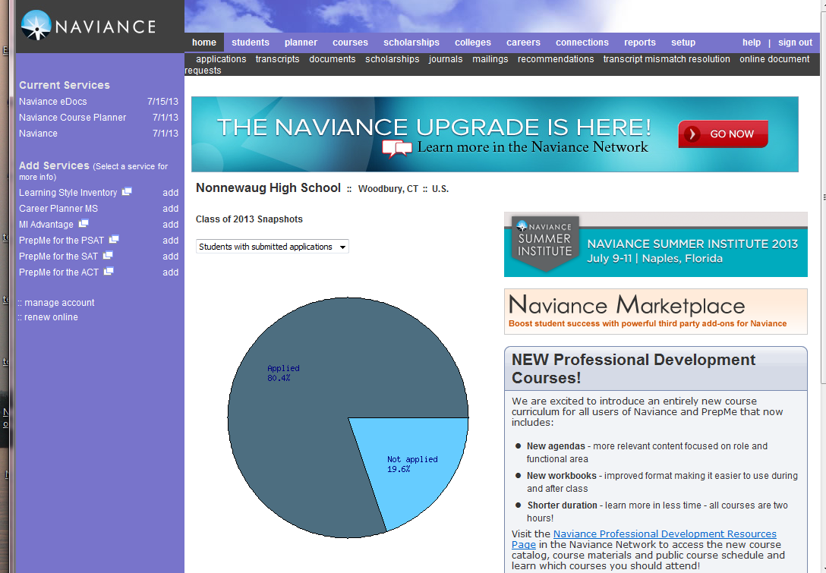
Electronic SSP’s
Components of SSP within Naviance
Survey Section
SSP’s middle school
Personalized Education Plan - Grade 9
Game Plan Survey
Do What You Are (personality profiler)
Career Interest Profiler
Sophomore Career Project
Success Planner
Post-Secondary Searches
Graduation Survey (documentation of finalized post-secondary plans)
Journal – Student Success Plan Portfolio
NHS uses Naviance

Slide 26
Where to get more information
CT State Department of Education
Secondary School Reform Link
SDE Contact Persons:
June Sanford, Jocelyn Mackey, Judi Andrews
Region 14 School District
Pamela Sordi, NHS Dept. Chair of School Counseling
psordi@ctreg14.org
203.263.0253

