Slide 1
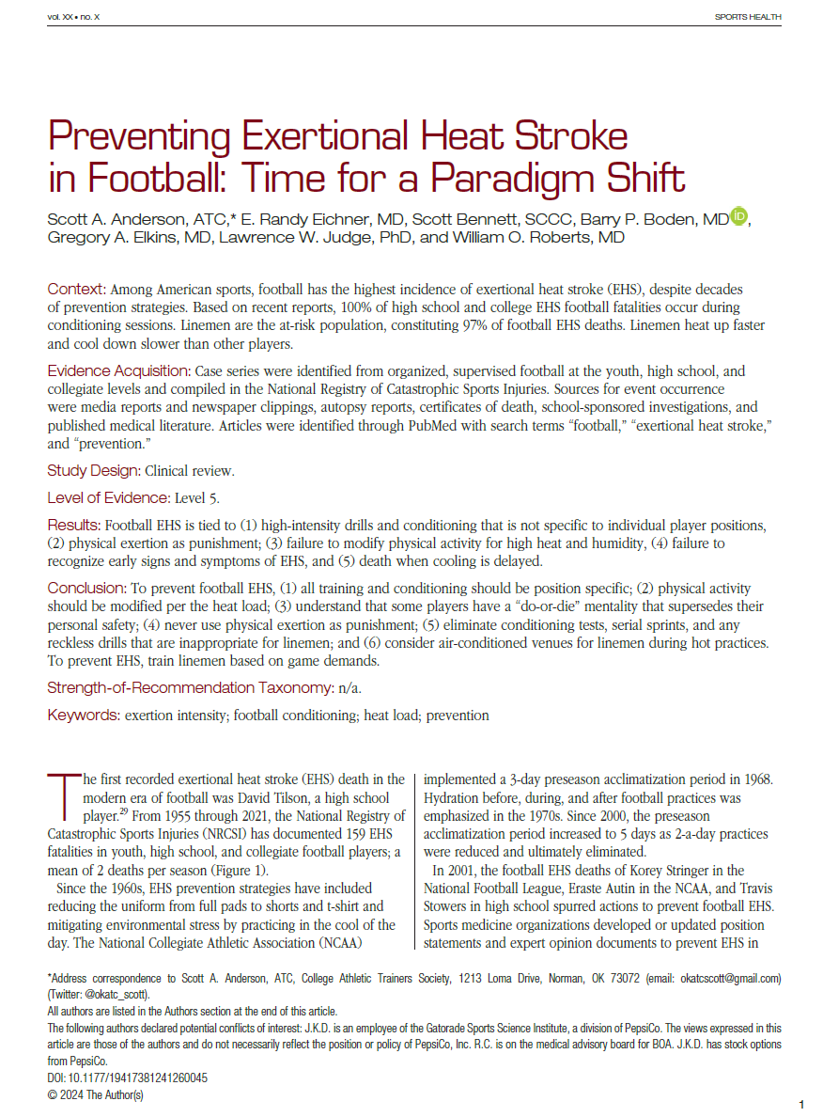
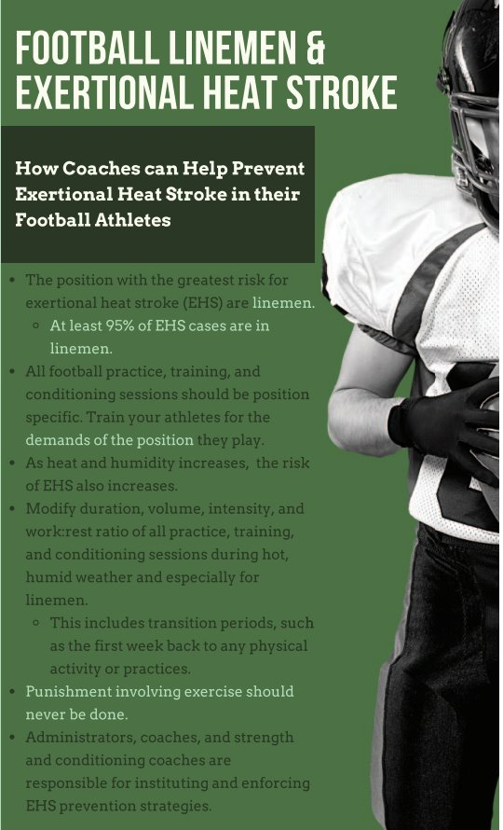
Preventing Exertional Heat Stroke in Football
100% of high school EHS deaths in football occurred during conditioning sessions
Linemen are the at-risk population (97% of football EHS deaths)
Paradigm Shift:
  Position specific training
  Transition period protocols
  Recognize high risk situations
  Eliminate punishment drills
Sports Health,
May-June 2025

Slide 2

2026 NFHS SMAC TASK FORCE
Preventing Exertional Heat Stroke (EHS) in High School Football Linemen

