Slide 1

CAAHPE: Connecticut Physical Fitness Assessment Individual
Student Collection
March 15, 2023

Slide 2
Collecting Student Level
CPFA Achievement Levels
What is your role as it relates to CPFA?
Teacher
Administrator
Tech Person
Other

Slide 3
Collecting Student Level
CPFA Achievement Levels
Was the CPFA test or standards changed prior to this school year?
Yes
No
Maybe

Slide 4
Agenda
A New Approach to Collecting CPFA Data
CPFA Available Resources/Contacts
CPFA File Layout and Codes
CPFA System Access
CPFA System Data Entry
CPFA Reports
CPFA Standardized Administration

Slide 5
A New Approach to Collecting CPFA Data
The change to collecting individual student achievement levels will:
Improve the overall quality of the data collected.
Allow for the inclusion in the participation rate of groups not being held to the state standards (alternate assessments and nonbinary students choosing not to be held to a gender-based standard).
Address one of the suggestions of the CSDE’s accountability system found by outside reviews.

Slide 6
A New Approach to Collecting CPFA Data:
Development
Working with an advisory group of district leaders in the Health/PE field, the CSDE began the conceptual phase for the new system over a year ago.
Beginning last spring, we have periodically met with and been in discussions with PowerSchool and Infinite Campus to ensure their systems can output the proper data for submission.
Since August, a CSDE development team has worked to create the new system and plan out its continued improvement.
In December, a pair of districts tested the site to identify weaknesses and ensure functionality.

Slide 7
A New Approach to Collecting CPFA Data
What will Teachers in the Field Need to do Differently?
It depends. Individual districts and even schools required different staff to manage and summarize data under the old reporting rules.
  If your district had individual instructors only submit the completed class/gender Data Collection and Reporting Form, a PE teacher may need to do nothing different.
  If your district had you submit summarized class level results, you need to hold on to your Data Collection and Reporting Forms.
  If your district had you enter student-level results in a student information system (PowerSchool, Infinite Campus), Google Sheet, or other system, you may not need to change anything in your approach.
You may be required to enter student level results into your district’s chosen system. This is a local decision.

Slide 8
A New Approach to Collecting CPFA Data
Our Message to Districts has been:
Many districts’ past approach to collecting and managing CPFA results will not be sufficient to complete the new collection.
Districts are advised to consult with and involve their data reporting staff, particularly:
  PSIS reporting staff
  Data base administers
  SIS specialists
  Experts in MS Excel and/or MS Access
  Colleagues in other districts

Slide 9
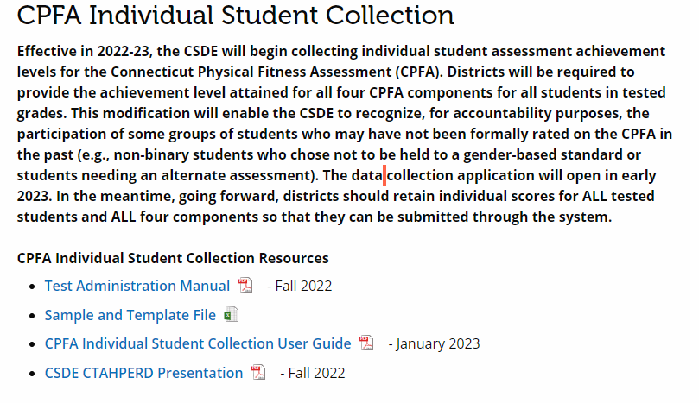
CPFA Available Resources/Contacts
CPFA Individual Student Collection Page
Test Administration Manual
Sample and Template File
CPFA Individual Student Collection User Guide

Slide 10
CPFA Available Resources/Contacts
Question Type | Who Does One Contact?
PowerSchool Entry Question | Local PowerSchool District Contact
Infinite Campus Entry Question | Local Infinite Campus District Contact
CSDE CPFA Individual Student Collection Application Question | ctstudentassessment@ct.gov
CPFA Policy/Administration Question | ctstudentassessment@ct.gov

Slide 11
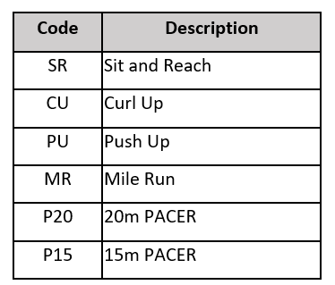
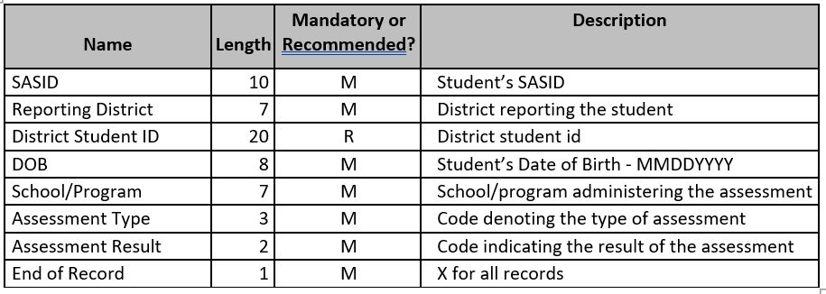
CPFA File Layout and Codes
The CPFA Individual Collection application allows for entry of results two ways: data file upload and manual entry. The file upload function requires a specific file type (CSV) and format (see below).

Slide 12
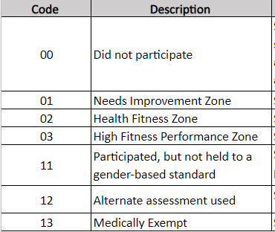
CPFA File Layout and Codes
Result Codes

Slide 13
CPFA File Layout and Codes:
Special Situations
Did Not Participate: The student did not take the assessment. This includes but is not limited to students who refused to be assessed, were absent/ill during testing and not assessed upon their return, and those who were not assessed after an initial assessment was deemed invalid.
Participated, but not held to a gender-based standard: Students who participate in the standard assessment but use a customized or personalized set of standards. For example, nonbinary students who choose not to be held to a gender-based standard.
Alternate Assessment Used: Students with physical disabilities or conditions are expected to participate in the CPFA to the best of their abilities. For students who cannot access the assessment with accommodations, they may need an alternate assessment. These students are not considered exempt from testing. Instead, schools should have a process in place for determining those activities and standards that are appropriate for an individual student.
Medically Exempt: For a student to be considered medically exempt from taking the CPFA, they must be unable to attend school due to a documented medical condition. Given that the CPFA can be administered throughout the school year, it is likely that few students would qualify for a medical exemption.

Slide 14
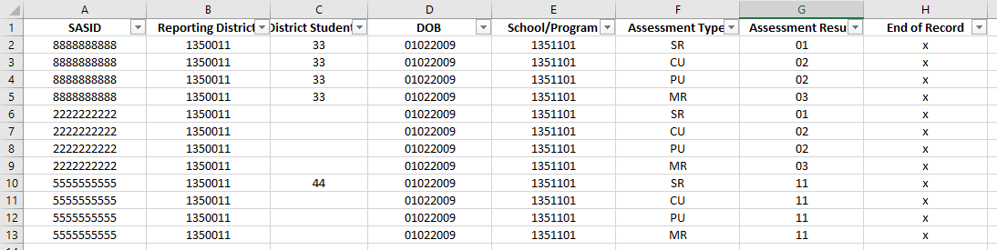
CPFA File Layout and Codes:
Sample File Example

Slide 15
CPFA System Access
The CPFA Individual Student Collection Application uses the state’s Directory Manager (DM) application and is accessed through the CSDE’s data collection portal (https://csde.ct.gov). Each district has at least one staff member with a DM role called “LEA Security Manager.” This person(s) manages the access to and right in the portal for their district. Each district’s LEA Security Manager is responsible for assigning and maintaining CPFA Individual Collection roles in DM.
  If an individual already has a DM account, they will use their existing username/password.
  If an individual is new to DM, they will receive one email with a unique username and a second email with a password.
If you do not know who your LEA Security Manager is, view this listing of all LEA security managers.

Slide 16
CPFA System Access
Name | Required Role | Permissions | Notes
CPFA LEA Certifier | Yes | Enter Data View Reports Certify Data | Must be a certified administrator
CPFA LEA Writer | No | Enter Data View Reports | Can be any staff member in the district This role is not designed for school level staff

Slide 17
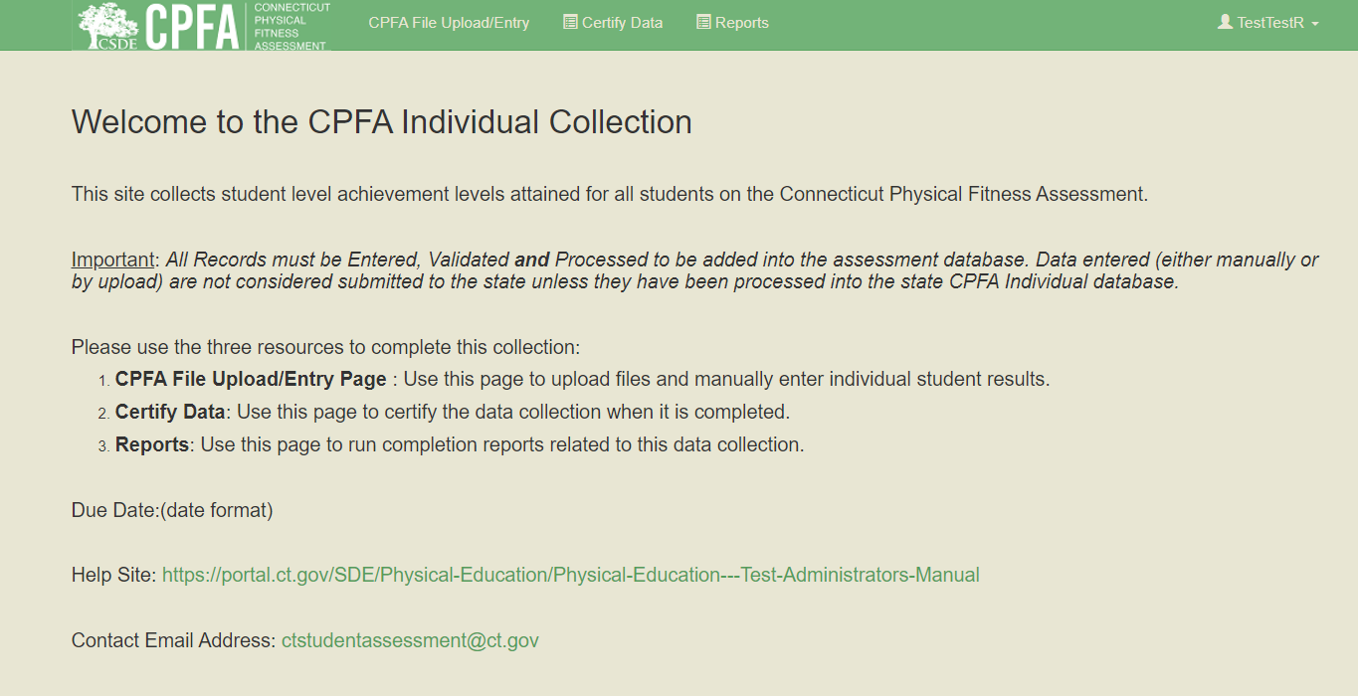
CPFA System Data Entry

Slide 18
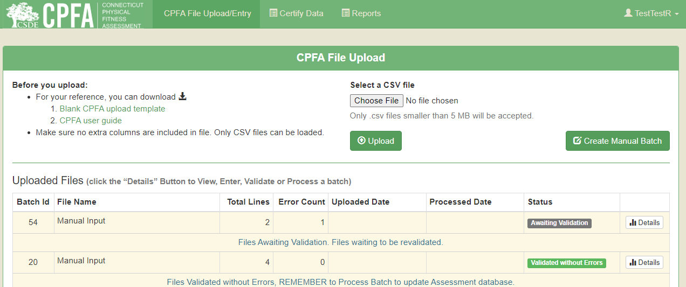
CPFA System Data Entry

Slide 19
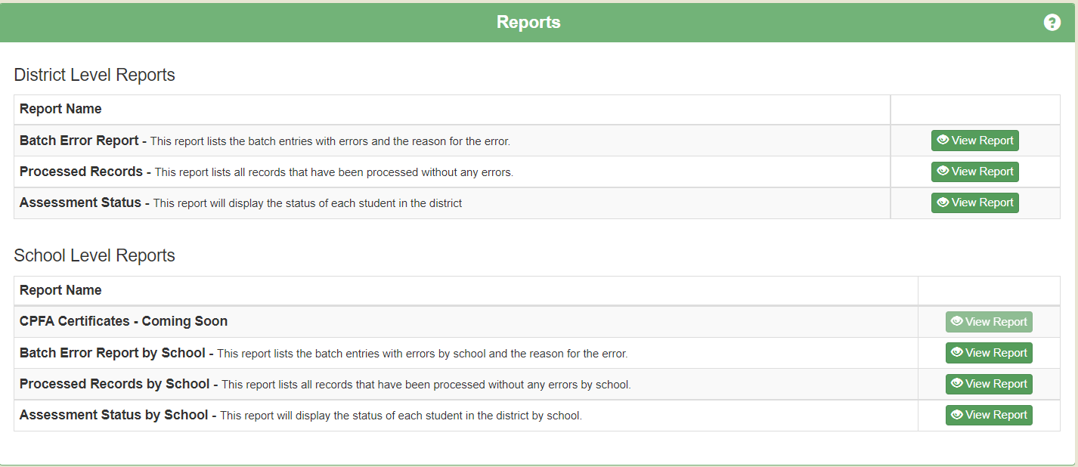
CPFA Reports
The CPFA Individual Student Collection application has a series of reports available at the school and district levels found on the Reports page of the application. Each of these reports can be searched, printed, and exported to a variety of file formats.

Slide 20
CPFA Reports
Report | Description
Batch Error Report | This report lists the batch entries with errors and the reason for the error​. This report can be run at either the school or district level.
Batch Input (No Errors) Report | This report lists all records that have been processed without any errors.
Assessment Status | This report will display the status of each student in the district in tested grades. This report allows district to identify which students have results for all assessments processed and which students still need results loaded and/or processed. Note: assessments results that have been loaded and validated, but not processed (i.e., loaded into the assessment database) are not reflected on this report.
Processed Records | This report lists all records that have been processed without any errors. Remember: only processed records have been entered into the assessment database and therefore are considered submitted to the CSDE. This means only the records on this report are officially submitted.
CPFA Certificates | This report will be coming soon.

Slide 21
CPFA Standardized Administration
Test Standardization and Validity is extremely important.
After the official administration has occurred, schools may not:
  re-test some or all students in hopes of getting better results;
  use pre-test results of a student who refused to participate or who was temporarily unable to be assessed; and
  dismiss the results of the official administration and use the results of a pre-test in its place.

Slide 22
CPFA Standardized Administration
Other Reminders for Standardization:
  Test administrators must review the online assessment videos prior to the administration of the CPFA. These videos are designed to ensure consistency and accuracy in administration of testing procedures and maximize efficiency.
  Students may not be used as scorers during testing. Using well-trained students is a productive teaching strategy during the instruction and practice of the tests but scoring their peers’ test performance is not allowed.
  Validity of the data is compromised if the tests are administered incorrectly:
    if there are errors in recording the results,
    if the examiners and/or students did not take the testing process seriously, or
    if teachers did not approach the assessment with professionalism.

Slide 23

Questions
Questions

