Slide 1
A Guaranteed, Viable, and Engaging Curriculum
Simsbury Public Schools
Notes:
The primary school level factor in raising student achievement.
Written ~ Implemented ~ Assessed

Slide 2
Implementing the Connecticut Core Standards ~ Key Components:
Capacity Building and Leadership Development
Realign Fiscal and Human Resources to Support
Communication and Stakeholder Engagement
Alignment of Instructional Materials & Programs
Curriculum, Instruction, & Assessment
Notes:
Paying attention to all components has been a critical aspect of our work:
Capacity Building and Leadership Development – ensuring that our principals, department leaders. Resource teachers have the knowledge and skills to lead this work – SPS Teaching Standards
Communication and Stakeholder Engagement – teachers, parents – PD sessions, PTO presentations, Newsletters from the superintendent and principals on a regular basis
Curriculum, Instruction, & Assessment – the written, the implemented and the assessed -
Alignment of Instructional Materials & Programs – non-fiction texts, movement of concepts from grade levels along with materials, including three genres of writing in each grade level, rubrics
Realign Fiscal and Human Resources to Support – textbook $, PD alignment, Instructional Coaches, Technology

Slide 3
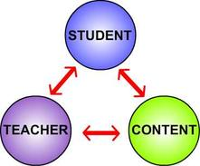
The Instructional Core
The only way to improve student learning is through focusing on the elements of the ‘CORE’
A “tight” relationship among content, instruction and assessment = Increased Student Learning
Notes:
In addition to the components just mentioned, we utilized the instructional core as a “checks and balances” tool as we work through any changes and/or realignment that we are addressing. We talk to teachers about this as well to ensure that they are understanding the importance of balancing these elements.
The rigor of the content also the instructional strategies and assessment strategies
The role of the student – engagement and the way in which they attempt each task
Teacher knowledge , skill and role in the instructional practice; instructional strategies

Slide 4
Four Principles of The Instructional Core
Increases in student learning occur only as a consequence of improvements in the level of content, teacher’s knowledge and skill, and student engagement.
If you change any single element of the instructional core, you have to change the other two.
If you can’t see it in the core, it is not there.
Task predicts performance.
Notes:
Increases in student learning occur only as a consequence of improvements in the level of content, teacher’s knowledge and skill, and student engagement.
If you change any single element of the instructional core, you have to change the other two.
If you can’t see it in the core, it is not there.
Task predicts performance.
Focus on task predicts performance

Slide 5
Definition of Curriculum:
Any document or plan the exists in a school or school system that defines the work of teachers. Curriculum identifies the content to be taught, the methods to be used in the process and the assessments used to measure student learning of that content.
(Adapted form English 2000)
Notes:
This is the foundation from which to work. You cannot say you have a guaranteed and viable curriculum for all students if you do not have “documents” that outline the content to be taught along with the methods to use – the instructional strategies, and then way in which you measure student learning.
How many of you have seen and used curriculum documents in your schools?

Slide 6
Design Features of 21st Century Curriculum:
Standards-Based
Connecticut Core Standards (i.e. CCSS)
Aligned (and coherent)
Vertically through the grades
Horizontally within sections of a course or among teachers in a grade
Differentiated (personalized)
Guaranteed (for ALL students)
Viable (time and resources)
Notes:
Overview of Curriculum and the importance of these five aspects when developing written curriuclum.

Slide 7
Curriculum should be…
Standards-Based
Aligned to the Connecticut Core Standards
Develops understanding by design
Incorporates 21st Century Skills
Develops high levels of reading, writing, mathematical, and critical thinking skills
Standards are not curriculum
Aligned and Coherent

Slide 8
Curriculum should be…
Differentiated
Find multiple pathways for students to demonstrate understanding of the standards (vs. differentiate the standards)
Alter the time and opportunity students have to learn the curriculum
NOT different standards for different groups of students
Guaranteed and Viable
All students are expected to learn the same curriculum – time and opportunity are the variables.
The curriculum can be taught in the time and with the resources provided

Slide 9
#1 School Level Factor: (Marzano) A Guaranteed and Viable Curriculum
Three Curriculum Frames:
Written Curriculum
Curriculum documents
Implemented Curriculum
Taught
Attained Curriculum
Tested
Notes:
In researching what works in schools, Robert Marzano (2003) found five school-level factors that promote student achievement. Ultimately, Marzano concluded that a guaranteed and viable curriculum is the most powerful school-level factor in determining overall student achievement.
If we truly have a “GVC” it means that, in our schools:
No matter who teaches a given course or grade level, we guarantee that topics identified in the curriculum will be covered in every class.
The content that teachers are expected to address can be covered in the time available.
Every student, in every class, every day, will be taught the same essential knowledge and skills (TEKS).
For students to achieve standards, Marzano states there must be a match between three types of curricula:
The written curriculum – content specified by the state, district, or school to be addressed in a particular course or grade level
The implemented curriculum – content that is actually delivered/taught by the teacher
The attained (tested) curriculum – content actually learned by the students
Understanding by Design
Concept-based Curriculum
Rigorous Curriculum Design

Slide 10
Notes:
Another way in which to support the work of alignment and tightening of the written, the imlmented, and the assessed.

Slide 11
Quality Control in Curriculum Development (English)
written
curriculum
taught
curriculum
tested
curriculum
(The Process of Tightening)
Notes:
This is the important way to pull together your curriculum, instruction, and assessments – using your work in PLCs, teacher evaluation, professional learning, etc.

Slide 12
Simsbury’s Model
Our Curriculum Alignment Action Plans
Simsbury Public Schools Curriculum Framework
1-D Map
2-D Map
3-D Map: Unit Design
Unit Design Standards
Standards
CCS (i.e. Common Core State Standards)
Content Standards (CT SS Frameworks, NGSS)
Unit Design Standards

Slide 13
CCSS Action Plan - Grades K-6

Slide 14
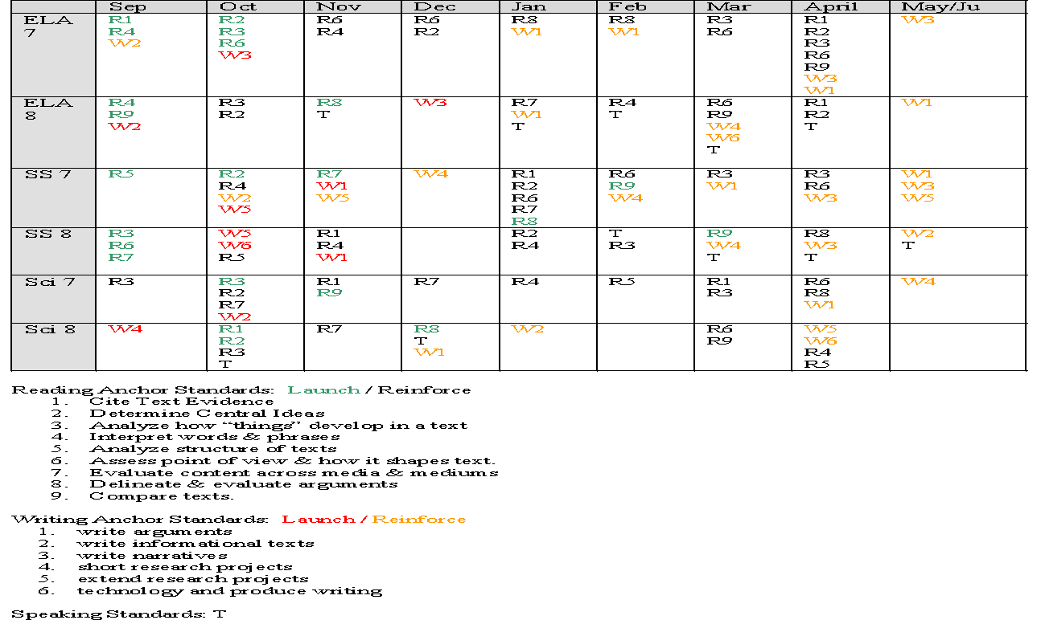
CCSS Action Plan - Grades 7/8 English, Math, Science, SS

Slide 15
CCSS Action Plan - Grades 9-11 English, Math, Science, SS

Slide 16
Curriculum Framework: Understanding by Design (UbD)
1-D Curriculum Map
Course Title
Course Description
Units listed
2-D Curriculum Map
Course Description – can be the description of the course found in the program of studies
Essential Learning Outcomes
Unit Name / Time Frame / CCSS / Knowledge & Skills / ELO connection / Assessment
3-D Curriculum Map
Stage 1
Desired Outcomes
Stage 2
Assessment Evidence
Stage 3
Learning Plan
~Simsbury Public Schools

Slide 17
SPS Curriculum Templates 2-D Map

Slide 18
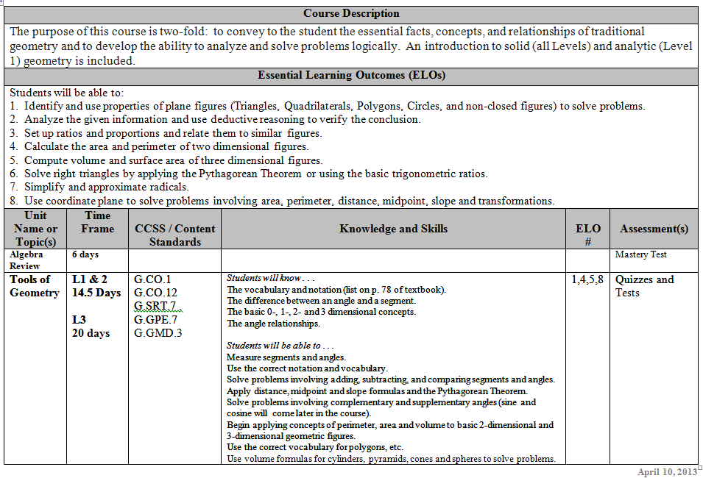
Example

Slide 19
SPS Curriculum Templates 3-D Map ~ Unit Design 3 Stages
Stage 1
Stage 2
Stage 3
Desired Results
Assessment Plan
Learning Plan

Slide 20
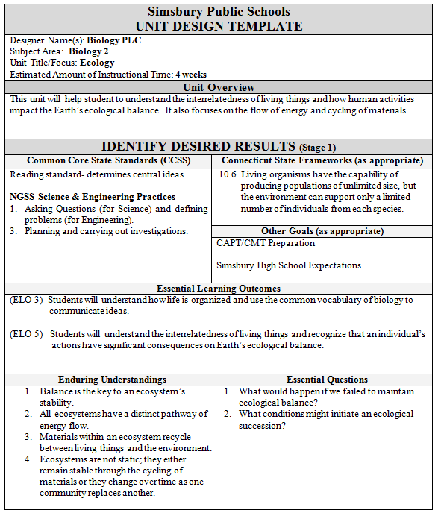
Unit Overview
Standards
ELOs
Understandings & EQs

Slide 21
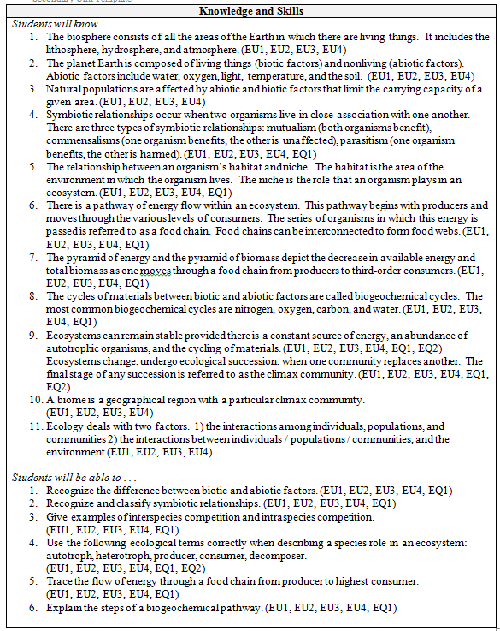
Knowledge
Skills

Slide 22
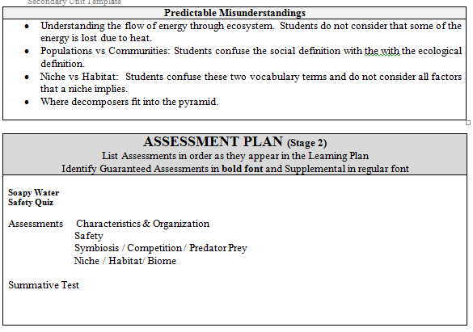
Where do these misunderstandings occur?
What are the ELOs, EUs, EQs, K, & S being assessed?

Slide 23
Assessment Plan K-12

Slide 24
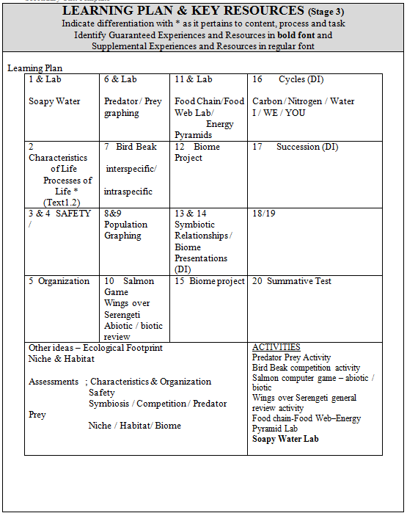
Estimated time of Instructional time:
4 Week Unit ~
20 Class Periods
What/where is the back-up to each lesson? Specific descriptors for each lesson need to be created and stored for each lesson, along with supporting materials.

Slide 25
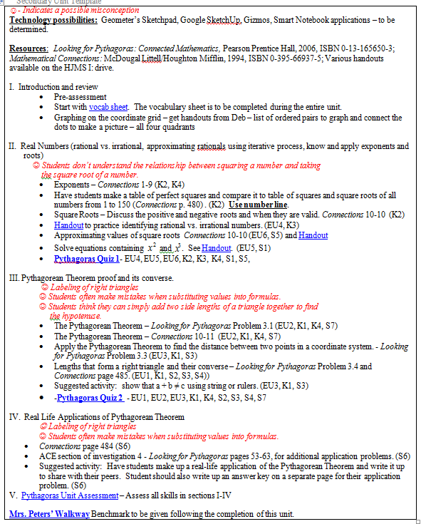
Grade 8 Math
Misconceptions noted
Hyper-links for student work
&
Assessments

Slide 26
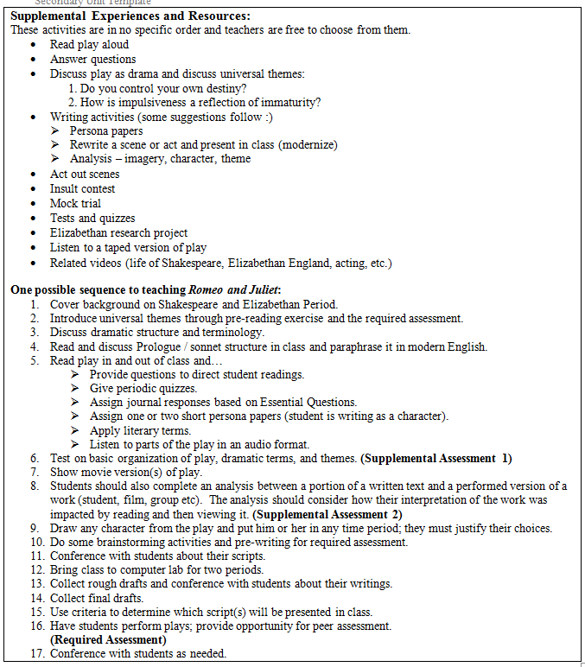
English 9
Supplemental Experiences and Resources
Possible Sequence to teaching Romeo and Juliet
What/where are the back-up materials?

Slide 27
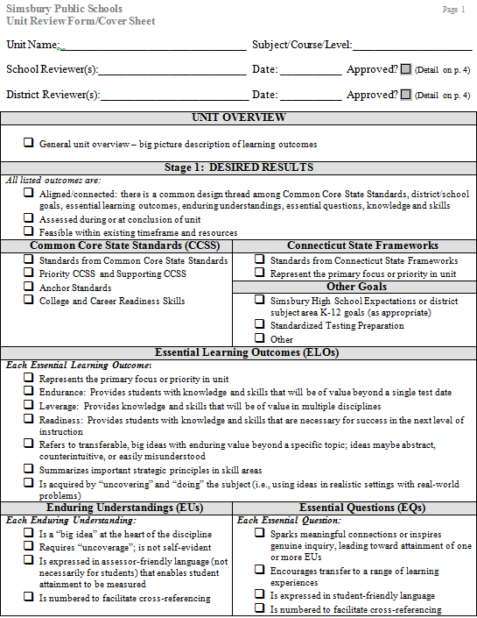
Unit
Design
Standards

Slide 28
Standards-Based
CCSS
Connecticut Core Standards
Content Standards – Science and Social Studies

Slide 29
Implementing the Connecticut Core Standards ~ Key Components:
Capacity Building and Leadership Development
Realign Fiscal and Human Resources to Support
Communication and Stakeholder Engagement
Alignment of Instructional Materials & Programs
Curriculum, Instruction, & Assessment
Notes:
Paying attention to all components has been a critical aspect of our work:
Capacity Building and Leadership Development – ensuring that our principals, department leaders. Resource teachers have the knowledge and skills to lead this work – SPS Teaching Standards
Communication and Stakeholder Engagement – teachers, parents – PD sessions, PTO presentations, Newsletters from the superintendent and principals on a regular basis
Curriculum, Instruction, & Assessment – the written, the implemented and the assessed -
Alignment of Instructional Materials & Programs – non-fiction texts, movement of concepts from grade levels along with materials, including three genres of writing in each grade level, rubrics
Realign Fiscal and Human Resources to Support – textbook $, PD alignment, Instructional Coaches, Technology

Slide 30
Questions?
Thank you!

