Slide 1
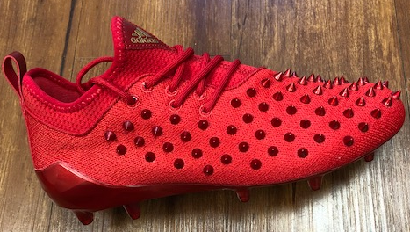
Adidas – Adizero 5-Star 7.0 spikes non-compliant with nfhs SOCCER rules for 2018

