Slide 1
CONNECTICUT STATE DEPARTMENT OF EDUCATION
Next Generation Science Standards
in Connecticut
CAS Webinar
November 17, 2015
Presenter: Liz Buttner, Science Education Consultant
Elizabeth.buttner@ct.gov

Slide 2
Connecticut State Board of Education Adopts
NEXT GENERATION SCIENCE STANDARDS
November 4, 2015
A Next Step for Connecticut Science Education
A set of learner outcomes designed to engage ALL students in “practicing” science the way real scientists do, and applying their knowledge to explain things in the real world.
Notes:
The vision is for all students to have a coherent progression of science learning across all grades, with each grade building on what was learned before to gradually deepen students’ understanding and abilities to reason with evidence and apply science knowledge to explain real-world phenomena.

Slide 3
Why Update CT Science Education?
Next step for CT’s 11-year old science standards
Recent research on how students best learn science
Captivate diverse students; close gaps
Consistent with CT Core Standards and College Board AP emphasis on thinking, reasoning and communication skills needed for life, college and workforce
Bring clarity to “STEM” education
Notes:
Connecticut’s K-12 Core Science Curriculum Framework (adopted back in 2004) and the accompanying State Board of Education Position Statement on Science Education – placed a high value on SCIENTIFIC INQUIRY as the set of skills and abilities that students USE in order to learn science ideas.
Connecticut’s science standards are now 10 years old. They’ve given us a strong foundation to build upon and yet we have not achieved their vision yet. Science content and scientific inquiry are still taught and tested separately and LARGE ACHIEVEMENT gaps on science assessments tell the story that the instructional “status quo” is ONLY WORKING for SOME students.
STEM Education has received national attention – from the White House to each State House. However, the term is not well defined. NGSS brings clarity to STEM Education as the integration and application of science knowledge and practices to engineer (design) solutions (technologies) to human problems.

Slide 4
Advances in HOW Science is Learned
Students’ Discussing & Critiquing Ideas
Curriculum that Builds Knowledge in Real-World Contexts
Science Applied to Engineering Design
Applying Science to Explain Real-World Phenomena
Students Reasoning with Evidence
Coherent Learning Progression Focused on BIG ideas
Students Integrating 3 Dimensions to Construct (not repeat) Explanations & Design Solutions

Slide 5
What to Look For in a Next Generation Science Classroom
Asking questions and defining problems
Developing and using explanatory models
Planning and carrying out investigations
Analyzing and interpreting data
Using mathematics and computational thinking
Developing explanations and designing solutions
Using data/evidence to support a conclusion
Obtaining, evaluating, and communicating information
Students Using Science & Engineering Practices to Construct Understanding
Notes:
Although the Science and Engineering Practices are not “new”, the way in which they are merged with science core ideas IS NEW. The 8 practices are used interchangeably throughout different stages of an investigation. They are not meant to be used in a rigid order (like “The Scientific Method”).
FOR REFERENCE PURPOSES:
Connecticut’s standards for Scientific Inquiry, Literacy and Numeracy (CSDE, 2004):
Grades 6-8 Core Scientific Inquiry, Literacy and Numeracy
How is scientific knowledge created and communicated?
Content Knowledge
SCIENTIFIC INQUIRY
Scientific inquiry is a thoughtful and coordinated attempt to search out, describe, explain and predict natural phenomena.
Scientific inquiry progresses through a continuous process of questioning, data collection, analysis and interpretation.
Scientific inquiry requires the sharing of findings and ideas for critical review by colleagues and other scientists.
SCIENTIFIC LITERACY
Scientific literacy includes speaking, listening, presenting, interpreting, reading and writing about science.
Scientific literacy also includes the ability to search for and assess the relevance and credibility of scientific information found in various print and electronic media.
SCIENTIFIC NUMERACY
Scientific numeracy includes the ability to use mathematical operations and procedures to calculate, analyze and present scientific data and ideas.
Expected Performances:
Identify questions that can be answered through scientific investigation.
Read, interpret and examine the credibility of scientific claims in different sources of information.
Design and conduct appropriate types of scientific investigations to answer different questions.
Identify independent and dependent variables, and those variables that are kept constant, when designing an experiment.
Use appropriate tools and techniques to make observations and gather data.
Use mathematical operations to analyze and interpret data.
Identify and present relationships between variables in appropriate graphs.
Draw conclusions and identify sources of error.
Provide explanations to investigated problems or questions.
Communicate about science in different formats, using relevant science vocabulary, supporting evidence and clear logic.

Slide 6
3-Dimensional Teaching and Learning:
What Counts as Evidence of Science Understanding?
Current Connecticut Standards
Next Generation Standards
Describe the effects of the strengths of pushes and pulls on the motion of objects.
Describe the basic structures of an animal cell, including the nucleus, cytoplasm, mitochondria and cell membrane, and how they function to support life.
Use mathematical operations to analyze and interpret data, and present relationships between variables in appropriate forms.
Plan and conduct an investigation to provide evidence of the effects of balanced and unbalanced forces on the motion of an object.
Develop and use a model to describe the function of a cell as a whole and ways parts of cells contribute to the function.
Use mathematical representations to support explanations of how natural selection may lead to increases and decreases of specific traits in populations over time.
Notes:
Develop new approaches to teaching and learning that integrate 3 dimensions of knowing science (practices, core knowledge, cross cutting concepts). Currently, inquiry skills are often taught separately from science concepts.
Learning in 3 DIMENSIONS is where CT science education could be transformed…by engaging students in using mathematics to analyze real data from their own investigations…and by reading, writing, speaking and listening to piece together information and build an explanation. We believe that this 3-Dimensional approach to science will be MORE accessible and engaging to DIVERSE students; not just to those who are strong readers or skillful memorizers.
In order to achieve the vision embodied in the Framework and to best support students’ learning, all three dimensions should be integrated into the system of standards, curriculum, instruction, and assessment.

Slide 7
Integrating Science , Math, ELA and Engineering to Understand Real-World Phenomena
Design a School Butterfly Garden:
Conduct tests for soil nutrients and water retention. Record hours of sunlight and average wind speed. Measure and mark a square foot grid to calculate the perimeter and area of the garden. Research butterfly life cycle and plant needs. Present information. Select plants adapted for site conditions…
Now we know what a “square foot” actually means!

Slide 8
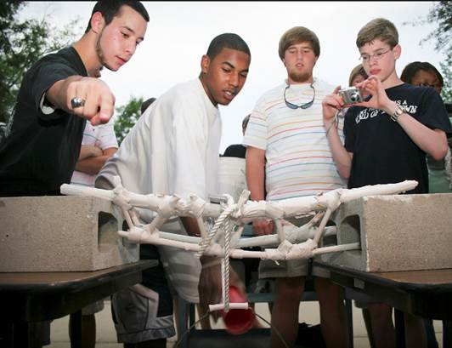
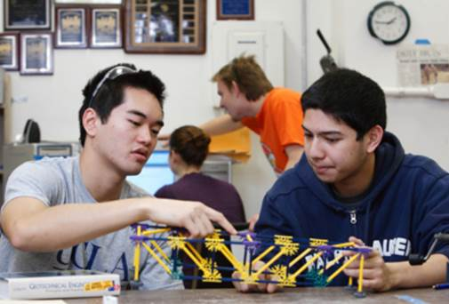
Integrating Science , Math, ELA & Engineering to Solve Real-World Challenges
Design, Construct and Model a Working Bridge:
Applying an understanding of forces to the working structure of bridges.
Using Engineering practices to test structural strength and expose design weaknesses.
Learning by doing

Slide 9
Science Supports CCS-ELA and CCS-M
CCS-ELA and CCS-M Support Science
NGSS 4-LS1-1: Construct an argument that plants and animals have internal and external structures that function to support survival, growth, behavior and reproduction..
CCS-ELA W4.1: Write opinion pieces on topics or texts, supporting a point of view with reasons and information.
CCS-M 4.G.A.3: Recognize a line of symmetry for a two-dimensional figure as a line across the figure such that the figure can be folded across the line into matching parts. Identify line-symmetric figures and draw lines of symmetry.

Slide 11
What to Listen For in a Next Generation Science Classroom
Students talk to each other; not just answer teacher questions
Build on and challenge each others’ explanations
Develop language skills, social skills and team mindset
Discussing and Critiquing Ideas and Evidence
Notes:
Prior to this classroom sense-making discussion, these students were not sure whether size or weight of a sunken object would determine how much the water level would rise. They experimented by placing cubes made of different materials -- copper and aluminum – into a container of water and they recorded the rise in water level.
Notice how this example of the Practice of “Constructing Explanations” differs from a traditional classroom in which the teacher poses a question – having a right answer in mind – calls on a student to give an answer, indicates if the answer is correct and then moves on to another question.
Let’s listen in to hear students explaining their thinking…

Slide 12
Questions About the NGSS Vision?

Slide 13
Time and Support for Systemic Change

Slide 14
Supporting Systemic Change to Next Generation Science Over Time
On-going Professional Learning
Curriculum Adaptations
Instructional Adaptations
Assessment Adaptations
Redesigning Existing Learning Units
3-Dimensional Teaching & Learning
3-Dimensional Performance Expectations
Accessing Available Learning Units
Notes:
What will be needed?
Upgrades to university teacher prep courses
Robust system of professional development available to all educators year-round
On-going communication with educators, families, policymakers, nonprofits and corporations
Partnerships with colleges, museums, aquariums and nature centers
Support from school administrators and school boards
Partnerships with business and foundations

Slide 15
DRAFT* 5-Year Implementation Timeline
2014-15
AWARENESS
NGSS PD for pre-service faculty & district science leaders
Develop new system of NGSS professional learning
2015-16
CAPACITY-BUILDING
Recruit and train expert PD facilitator cohort
Launch new system of professional learning
State Board of Education NGSS Adoption
2016-17
PROFESSIONAL DEVELOPMENT
District curriculum upgrades begin
NGSS Local Assessment Resources developed
2017-18
IMPLEMENTATION in Gr. 3, 6, 9
On-going PD
District curriculum upgrades continue
NGSS Local Assessment Resources Available (voluntary)
2018-19
IMPLEMENTATION in Gr. 4, 7, 10
On-going PD
District curriculum upgrades continue
NGSS Local Assessment Resources Available (voluntary)
State NGSS Low Stakes Test?
2019-20
IMPLEMENTATION in Gr. 5, 8, 11
On-going PD
NGSS Local Assessment Resources Available (voluntary)
NGSS state assessments
* Subject to change pending changes to federal law and state policies
Notes:
*NOTE: There are no multi-state assessment consortia for NGSS. Each adoption state is developing its own assessments guided by recommendations published by the National Academy of Science (“Developing Assessments for the Next Generation Science Standards”, National Academies Press, 2014).

Slide 16
Building a New System of Science Assessments*
State-Administered Summative Assessment
Indicators of Students’ Opportunities to Learn Next Generation Science
Local Assessment Resources (voluntary)
MORE TIMELY
MORE COMPLETE PROFILE OF STUDENT LEARNING
MORE INFORMATIVE
* Not approved by the State Board of Education or the CT General Assembly; subject to change.
CONNECTICUT STATE DEPARTMENT OF EDUCATION
Notes:
STILL IN THE EARLY PLANNING STAGES. WILL BE INFLUENCED BY INPUT OF STATE ADVISORY COMMITTEES (District Advisory Council and State Science Assessment Committee).
NGSS assessment is being influenced by National Research Council’s “Developing Assessments for the NGSS” which calls for development of a system of science assessments (from local classroom assessment resources to large-scale summative assessments).
NGSS assessments present many challenges, including assessing 3-dimensional learning (content, practices, and cross-cutting concepts) that require innovative, online items and tasks. NGSS assessments will require greater application of scientific knowledge to real-world scenarios and use of critical thinking skills. (High School AP science assessments are moving in this direction as well).
Over the next few years, CT will make NGSS assessment resources (e.g., performance tasks, practice tests, etc.) available to local districts to assist with the transition. These resources can be used on a voluntary basis with no or low stakes.
CT (in collaboration with other states and national groups) is developing a wide variety NGSS teaching resources and professional development opportunities to support the transition to NGSS assessments.
CLASSROOM ASSESSMENTS:
- high-quality instructional materials used in ways to yield assessment information
multiple components; various response formats, including those that require students to construct or supply an answer produce a product, or perform an activity.
Designed to guide instruction
Engages students in using science and engineering practices to learn about disciplinary core ideas and to make connections across topics.
Teachers will need to learn how to design tasks that elicit students’ thinking about core ideas and crosscutting concepts by engaging them in scientific practices. Challenging to design, implement and properly interpret student work. Extensive PD, and examples such as CSDE-developed performance tasks, will be needed
STATE MONITORING (“EXTERNAL”) ASSESSMENTS:
Assessing 3-dimensional performances with multicomponent tasks is time and resource intensive.
State policy makers should design the external component of the assessment system to incorporate “matrix-sampling” rather than requiring every student to take every item.
Existing and emerging technologies (computer-based simulations) will be critical tools .
Should provide fair and accurate measures of the learning of ALL students, including tasks and scoring procedures that reflect multiple dimensions of diversity, including culture, language, ethnicity, gender and disability.
INDICATORS OF OPPORTUNITY TO LEARN:
Evaluate district program effectiveness and equity
State should collect information to monitor quality of classroom science instruction and whether resources to support learning are provided (i.e., teacher qualification, subject area pedagogy, time, space, materials, etc.)
Contextual data (similar to what NAEP collects) contextualize and validate inferences drawn from assessment results.
Indicators can include: Inspections of school science programs, surveys of students and teachers, monitoring teacher PD programs, documentation of curriculum assignments and student work.

Slide 17
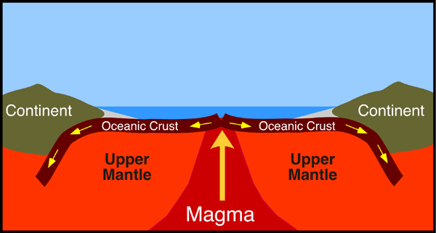
Contrast Traditional and NGSS Assessment Questions Source: Developing Assessments for the Next Generation Science Standards (Pellegrino, et al) http://tinyurl.com/qxsms89
Traditional
The major movement of the plates and description of plate boundaries of the Earth are...
Convergent
Divergent
Transform
All of the Above
NGSS-style
Draw on the picture to show what is happening in the mantle that causes the plates to move apart.
What is happening in the mantle that helps to explain why the two plates are moving apart?
Put an X on the places in the picture above where the oldest rock can be found in the crust.
Explain your answer.
Notes:
NOTE the traditional emphasis on recalling facts or terms compared with the NGSS approach to explaining phenomena using evidence.
SOURCE: National Research Council. (2013). Developing assessments for the Next Generation Science Standards. Washington, DC: National Academies Press.
“This picture shows a place on the ocean floor where two plates are moving apart. At this plate boundary, rock material is rising to the surface.”

Slide 18
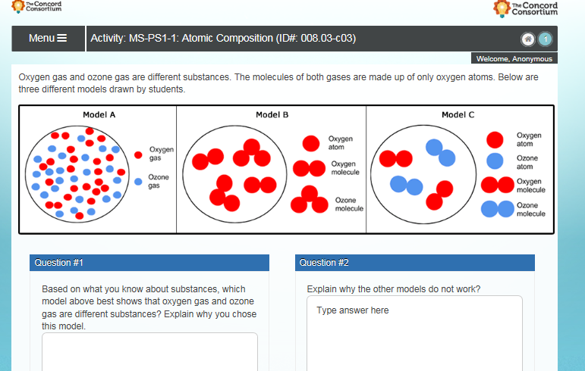
Sample NGSS Assessment Task to Elicit Evidence of Understanding Source: http://ngss-assessment.portal.concord.org/
Performance Expectation MS-PS1-1: Develop models to describe the atomic composition of simple molecules and extended structures.

Slide 19
System of Professional Learning
CSDE-Trained Professional Learning Facilitators
Intro to Framework & NGSS
On-line Modular
Short Course
Launch
November 2015
Next Gen Science
Pedagogy
On-line Modular Short Course
Launch
January 2016
Next Gen Science Inquiry
In-Person Institute
Launched
Summer 2015
Curriculum Design Institutes
In-Person Content-Specific Institutes
Launch 2016
Performance Task Workshops
Launch 2016
Learning Unit Workshops
Launch 2016
NGS-CT District-led Study Groups
NGSX
Expert-Led Regional Study Groups
CT Science Center
CT Science Center
Notes:
The CT State Department of Education has been partnering with NGSS authors and the CT Science Center to design professional development opportunities to be READY FOR THE 2015-16 SCHOOL YEAR and beyond. CSDE will make available a series of short courses and institutes – both in-person and on-line -- for educators statewide for years to come:
Leadership Development Academy (summer 2015) – Together with NRC Science Framework authors, CSDE is partnering with CT Science Center to develop a cohort of 25 expert learning facilitators to lead regional study groups statewide during school year and summers for years to come. Academy Fellows selected through a competitive application process.
Next Gen Science teaching institutes and short courses: Intro to NGS-CT (no-cost), Next Gen Science Pedagogy (NGSX – low cost) and upgraded Inquiry Practices Institutes. WATCH FOR REGISTRATION ANNOUNCEMENTS IN FALL 2015 THROUGH CSDE AND CT SCIENCE CENTER.
Next Gen Science curriculum design institute: Teams of teachers from multiple districts collaborating under expert facilitation to design learning units around NGSS core ideas and approaches.
Performance Task Workshops: Facilitated one-day workshops addressing effective implementation of science Performance Tasks that integrate Science, Technology Design, Engineering, and Common Core Math and Literacy (“STEM”).
Learning Unit Workshops: 2-day workshops that introduce teachers to samples of coherently sequenced learning units that engage students in using Science and Engineering Practices to generate evidence and develop scientific explanations of real-world phenomena.

Slide 20
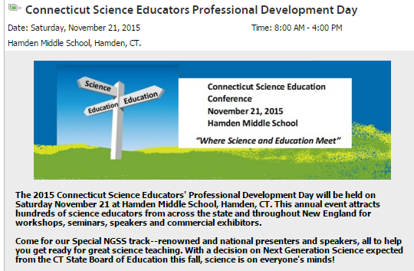
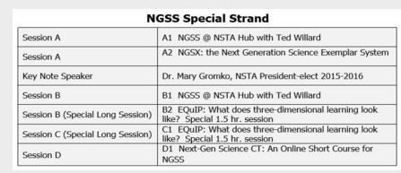

Slide 21
Online course
Broad introduction; no prior NGSS knowledge required
Designed with and for CT educators
No-cost
Designed for PLCs; works best with an effective facilitator of discussion; or
Join an on-line discussion
Modules 1-3 available now; 4-15 to be released over the coming months
Can earn emailed certificate & badge
1 | Introduction
2 | Overview of Next-Gen Science
3 | Next-Gen Practices Overview
4 | New/High Priority Practices
5 | Disciplinary Core Ideas Overview
6 | Crosscutting Concepts Overview
7 | Nature of Science Overview
8 | Engineering
9 | Equity & Diversity Overview
10 | NGSS Architecture
11 | Assessment Overview
12 | Curriculum Overview
13 | Putting It All Together
14 | Transition Planning
15 | Wrap-Up
CONNECTICUT STATE DEPARTMENT OF EDUCATION

Slide 22
Web-based seminar
Learn about Next Gen Science directly from authors of the standards and with CT’s certified learning facilitators
Focus on modeling, argument with evidence and scientific explanation of real world phenomena
Registration opens Nov. 19 for winter, spring and summer sessions (15 options) in all parts of the state
To get a sense of the NGSX learning experience, go to:
http://www.ngsx.org/index.php/public/home

Slide 23
Supports for Teachers
Teaching Resources
Sample Learning Units
Coming Spring 2016
Sample Performance Tasks
Classroom Assessment Resources
Coming 2017
NSTA NGSS Hub
Notes:
Sample Learning units are being developed through a State-funded project that brings together K-12 teachers with Framework authors to work together on designing instructional materials that exemplify the Framework’s vision of 3-dimensional teaching and learning. Available in Fall 2015.
The CT State Department of Education is coordinating the work of CT science teachers in the development of next generation science performance tasks for use by local districts. Some of the tasks are modified versions of existing curriculum-embedded tasks while others are new. Tasks have been developed and are being pilot tested in spring 2015.
Achieve’s sample classroom performance tasks blend content, practices, and concepts from both the NGSS and the Common Core State Standards. Teachers across the disciplines collaborated to write sample tasks, which are the result of a vision of integrating science, engineering, and mathematics for classroom use. The tasks are available at www.nextgenscience.org (under Implementation - Resources).
Classroom assessments resources will be developed by teachers in CT in collaboration with other states. These will include optional assessments to inform daily curriculum and instruction as well as to monitor student learning at the end of units or the year.

Slide 24
Questions and Discussion

Slide 25
Getting Involved and Staying Informed
CSDE Science mailing list – Elizabeth.buttner@ct.gov
District Advisory Council – contact Liz Buttner
State Science Assessments – contact Jeff Greig at jeff.Greig@ct.gov
Science Performance Tasks – contact Ron Michaels at Ronald.Michaels@ct.gov
Notes:
Sample Learning units are being developed through a State-funded project that brings together K-12 teachers with Framework authors to work together on designing instructional materials that exemplify the Framework’s vision of 3-dimensional teaching and learning. Available in Fall 2015.
The CT State Department of Education is coordinating the work of CT science teachers in the development of next generation science performance tasks for use by local districts. Some of the tasks are modified versions of existing curriculum-embedded tasks while others are new. Tasks have been developed and are being pilot tested in spring 2015.
Achieve’s sample classroom performance tasks blend content, practices, and concepts from both the NGSS and the Common Core State Standards. Teachers across the disciplines collaborated to write sample tasks, which are the result of a vision of integrating science, engineering, and mathematics for classroom use. The tasks are available at www.nextgenscience.org (under Implementation - Resources).
Classroom assessments resources will be developed by teachers in CT in collaboration with other states. These will include optional assessments to inform daily curriculum and instruction as well as to monitor student learning at the end of units or the year.

