Slide 1

Collaboration Matters
January 12th, 2016
Ryan Cleary & Mary Lestini
West Hartford Public Schools

Slide 2
Who are we?
Ryan Cleary - Principal of Morley Elementary School, WHPS. Served as classroom teacher, curriculum specialist, and principal during CCSS implementation
Mary Lestini - Townwide Elementary Math & Science Curriculum Specialist, WHPS. Served as a building-based and townwide curriculum specialist during CCSS implementation
Our plan:
  Share WHPS blueprint for CCSS implementation
  Discuss impact of CCSS implementation on district climate and student achievement
  Have time to collaborate/connect with colleagues
Notes:
WHPS consists of approx. 4,100 elementary students; approx. 212 elementary (K-12) classroom teachers; 20% F& R lunch district wide

Slide 3
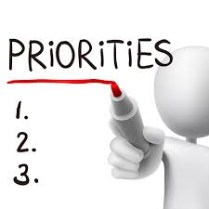
What are your expectations for this session?
We’ve shared our plan, what are your priorities?
To learn about a district's (WHPS) approach to CCSS implementation?
To share your own successes/challenges with CCSS implementation?
To connect with other leaders/have a chance to talk in small groups about CCSS implementation?
Other…?
Notes:
Use ‘Poll Everywhere’ to elicit headlines.

Slide 4

CT Standards for Professional Learning
Leadership
Learning Designs
Implementation
Learning Communities
Resources
Outcomes
Data
Cultural Competence
Notes:
These 8 standards define the characteristics of a high-quality system of professional learning and are important to the design, implementation and sustainability for a professional learning system. (see handout)

Slide 5
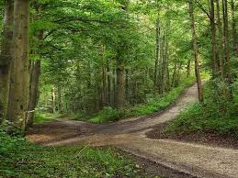
How our story begins ...
K-12 teachers and district leaders came together as one initial team to translate the CCSS through our own/district lenses
Subject area based grade-band vertical alignment
Formation of grade level curriculum writing teams (and eventually review teams)
Notes:
Seems simplistic but this the foundation of our work - needed to be solid and was a 7 day investment well worth the rewards

Slide 6

Beginning Pathways
Kindergarten, Grades 2 & 4:
Year 1 (2012 -13) = ELA
Year 2 (2013-14) = Math
Grades 1, 3, & 5:
Year 1 (2012 -13) = Math
Year 2 (2013-14) = ELA
Notes:
We began with an implementation plan that we feel we could support and that would not overwhelm the teachers - hence the staggered grade level roll out
created natural gaps (address later)

Slide 7

Structure of professional development
Years 1 and 2: (the ‘What’ - content)
Content CSIs (Planning and practice)
Collaborative CSIs (Planning and practice)
Years 3 and 4: (the ‘How’- instructional practice)
District CSIs (MPs, TPs, math discourse, etc.)
Collaborative partner schools
Notes:
Years 1 and 2: (the ‘What’ - content)
Content CSIs (Planning and practice)
Collaborative CSIs (Planning and practice)
Years 3 and 4: (the ‘How’- instructional practice)
District CSIs (math practices, teaching practices, math discourse/ talk moves,
Years 1 and 2: (the ‘What’ - content)
Content CSIs (Planning and practice)
Collaborative CSIs (Planning and practice)
Years 3 and 4: (the ‘How’- instructional practice)
District CSIs (math practices, teaching practices, math discourse/ talk moves,

Slide 8

All along the way...
Opportunities for feedback at different levels
Revisions to units
Transparency
Learning Leaders
Notes:
Feedback - District and school level. District at content and collaborative CSIs, school level through PLCs, CSIs, staff meeting. Collected and analyzed feedback
Revisions - Based on feedback, guided by district and school CSs. Ongoing!
Transparency - Being open about where we are in the processing, learning together
Learning Leaders - Learning together, collaboration between teachers and building administration

Slide 9

Pit Stop
Connect with the people around you:
What pieces of our structure do you connect to right away (if any)?
What pieces give you the “NO WAY!” reaction?
How does this relate to your experience in your school/district?

Slide 10
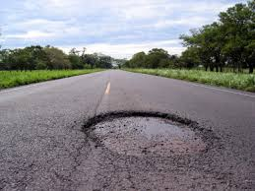
Potholes (Challenges):
Time
Starting with the “What” and then embedding the “How”
  Making content CSIs not feel like teacher prep. coursework
  “Teachers used this forum (collaborative), in some cases, to complain about the units and content instead of embracing a new challenge and getting their hands dirty.”
Filling in the ‘gaps’
The test
Notes:
Time (time to plan, time for PD, time to explain to families, time for teachers and CSs out of the building)
Starting with the “What” and then embedding the “How” (insert negative content CSI feedback quote?)
Filling in the ‘gaps’ (instructional gaps for teachers, resulting content gaps for students - with increasing difficulty/ expectations of standards - especially in math)
The test (SBAC, and its relationship with unit assessments)

Slide 11

We’re here!
Deeper professional learning
Continuous model of improvement
Student results
Notes:
Deeper professional learning (school and district levels)
Continuous model of improvement -> Mindset shift has allowed other initiatives to roll out more smoothly based on prior learning (i.e. writer’s workshop).
Student results

Slide 12
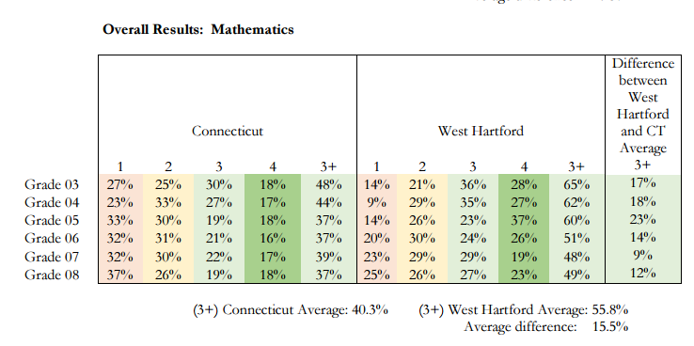
The Checkered Flag

Slide 13
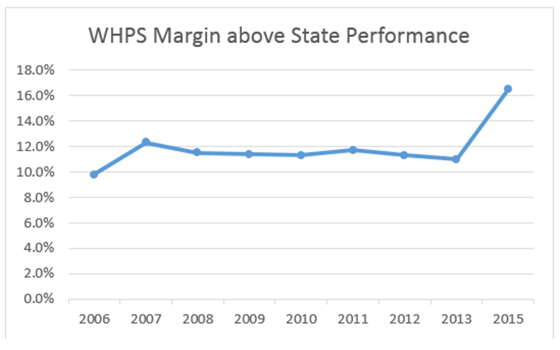
Notes:
Combining Literacy and Mathematics in order to discuss overall performance,
We observe that our 16.5 point difference from the state average is the highest margin of difference that we have ever observed in state testing, far exceeding our eight year trend of scores approximately 12 points above the state average.

Slide 14
Journey Reflections
“The collaborative sessions have been helpful. It is important to get together in small groups with other building to share ideas and resources and to align ourselves with pacing, etc.”
“Time to plan and collaborate as a team. It was also helpful to have district level experts to ask questions from and get recommendations as to the best way to implement these units.”
“Touching base with teachers who have tried components of a unit and can give advice on how to proceed.”
“Our Collaborative leader was sooo willing to listen to what we needed! We shared among the schools and offered ideas and suggestions. We were able to problem solve together. We were also given the opportunity to direct our focus of the time on what we felt was most important.”
“It is helpful to hear what issues/struggles other schools are working through. Their feedback is beneficial. It was most helpful to meet after we had taught a unit because could discuss the units with more expertise.”

Slide 15
Looking Back
Leadership
Learning Designs
Implementation
Learning Communities
Resources
Outcomes
Data
Cultural Competence

Slide 16
This part of the journey ends but the next one begins...
Key Takeaway: Collaboration throughout the process has had a positive impact on instructional improvement and student achievement.
Collaboration strengthens relationship between administration, curriculum developers, PD facilitators, and classroom teachers (district climate).
Collaboration creates opportunities for learning that develops deeper knowledge and more diverse toolbox for students (student achievement).
Based on this morning, how has your headline changed? In other words, what do you hope your headline will look like a year from now regarding CCSS?

