Slide 1
Building Bridges to Improve Student Outcomes:
One community’s journey
Jean Haughey, LMFT, Director, Town of Enfield Youth Services
Joanna Fornwalt, LCSW, Social Worker, Town of Enfield Youth Services
Cindy Stamm, Former Director, Pupil Services, Enfield Public Schools
Officer Rebecca Leger, SRO, Enfield Police Department

Slide 2
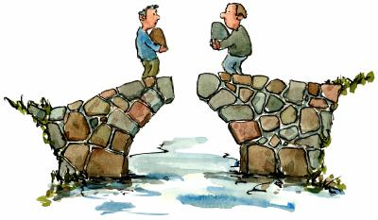
Overview
History of Building Bridges
  Response to Enfield’s youth suicides & untimely deaths
No one risk factor – No one solution
  Reducing the blame game
“Tools for Community “Crisis”
  Brought in State expertise
  Helping students, families, and community cope

Slide 3
CONNECT Postvention Summary
Responding in the aftermath of a tragedy
Community Needs Assessment by Sector

Slide 4

Community Mapping
Suicide is not caused by one single risk factor, but is a complex interconnecting set of risk factors.

Slide 5

What We Learned: Shared Risk Factors
Barriers to behavioral health treatment
  Lack of early identification of behavioral health disorders and substance abuse in youth
  Lack of awareness that substance use may mask a history of mood disorder and/or trauma
Delinquency
  Sending drug, alcohol and other misdemeanors to court
  School based arrests for disruptive and impulsive behavior
  Exclusionary educational practices

Slide 6

What We Learned: Shared Risk Factors
Family history of mental health/addiction
  Parental substance misuse at home
  Social access to alcohol, marijuana and prescription drugs
  Abuse and neglect
  Trauma
Feelings of isolation/relational and social losses
  School climate
  Bullying
  Exclusionary practices
  Lack of connectedness to school, family, and community
  Lack of communication among silos

Slide 7
Shared Protective Factors
Individual
  Religiosity
  Self regulation
  Coping ability
Relationship
  Connectedness to others
  Family and social support
Community
  Supportive school staff/environment
  Effective classroom management
Societal
  Cultural norms and practices

Slide 8
Action Steps
Improving community strength, resilience and capacity in suicide prevention
  Improving individual, family and community awareness and understanding of suicide and suicide prevention will increase the capacity of communities to prevent and respond to suicide.
Taking a coordinated approach to suicide prevention
  Effective suicide prevention relies on communities, organizations and all levels of government working together using sound evidence based practices with a careful assessment of outcomes
Providing targeted suicide prevention activities
  To address the needs of individuals and prevent suicide, there are a number of key elements:
  • Early identification and intervention;
  • Building individual resilience and the capacity for self-help

Slide 9
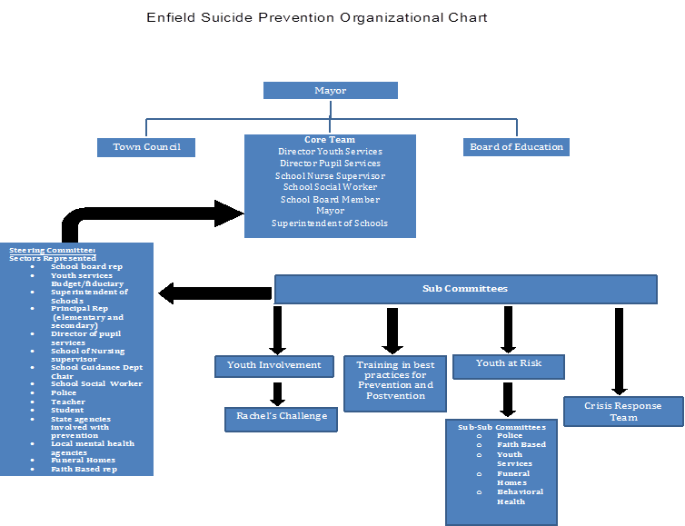

Slide 11
Resulting Committees and Collaborations
Crisis Response Team
Early Intervention Team
Behavioral Health Committee
Training and Resource Development Committee
Youth Involvement
School Climate and Wellness Committee
Wednesday Night School

Slide 12
Crisis Response Team
Members trained in psychological first aid and post traumatic stress management skills
Meets quarterly to review recent responses and trends within the community
Membership from community mental health, schools, police, town, faith based organizations, businesses, funeral homes

Slide 15
Training and Resource Development Committee
Key leadership positions needed from town youth services and Enfield Public Schools Pupil Services
  Membership also includes all levels school social workers and guidance, school nursing, school administration
Assess current areas of training needs and implement by sending identified participants to trainings or bringing in speakers during professional development days
Examples: Supporting transgender youth, adverse childhood experiences/trauma informed schools, school mental health, diversity in schools, substance use prevention

Slide 16
Trainings
Cross sector training - a few listed here:
    Harvard School Mental Health
    PTSM/Psychological First Aid
    Georgetown LEAD Conference
    CT Consortium on School Attendance
    National League of Cities
    CADCA

Slide 17

Funding Streams
Town Council
Grants
  Partnership For Success
  Garrett Lee Smith
  Drug Free Communities
  Stop Act
  ERASE
  SDE Enhancement
Donations
BOE funding

Slide 18
Capitalizing on Existing Work
Enfield Together Coalition
  Substance abuse prevention IS suicide prevention
Universal strategies to prevent substance abuse
  Enforcement of underage drinking laws
  Encouraging parental monitoring of youth alcohol/drug use
    “Talk, They Hear You” campaign
  Promoting awareness of social host laws
    “Love them enough to say “NO” campaign
  Promoting use of prescription drop box
  SBIRT initiative – screening at-risk youth through the juvenile review board, expulsion program, early intervention team, youth services counseling
  Prescription drug monitoring program
Student Survey – administered every 2 years
  Tailoring campaigns to meet assessed needs ie) current marijuana campaign as student reports of marijuana use has increased

Slide 19
Training Milestones
All 9th grade students trained in QPR annually
QPR training for paraprofessionals
Trainings requested in the community from local community college and faith organizations
2016 all staff training on adverse childhood experiences
2016-2017 school year
  Sent 42 school/town representatives to 8 different trainings
  Brought 2 trainings to Enfield during PD days
  Sent one EYS staff to youth mental health first aid train the trainer
  Sent 3 EYS/EPS staff to SOS train the trainer

Slide 20
Early Intervention Team
Response to Enfield JRB only hearing cases resulting in arrest
Piloted in K-2, expanded to all ages
Collaboration between Enfield Police Department, Enfield Public School, Enfield Youth Services, Local Behavioral Health Agency, DCF, and Juvenile Court
Expanded to school truancy, attendance, behavioral disturbances as alternative to arrests

Slide 23
Behavioral Health Committee
Membership from local pediatricians, community mental health, school nursing, all levels school staff, youth services
Carried out EPIC training with area pediatricians promote implementation of screenings at office visits
Promoting universal screenings for substance use and trauma
Collaborating with school based health clinic to implement CBITS and expanding services to elementary schools
School avoidance/anxiety/truancy
Breaking down barriers to communication between school, families, providers to ensure best treatment

Slide 24
Youth Involvement
Rachel’s Challenge
  Clubs at middle and high schools
  Positive school climate and kindness messaging
  “Chain Reaction” kick off events
  2nd grade mentoring program
  Pancake breakfast
  Kindness Carnival
http://rachelschallenge.org/about-us

Slide 25


Slide 26
School Wellness and Climate Committee
Developed 2016 in response to growing school attendance concerns and increased awareness of impact of trauma on learning
All levels school participation, community agencies, youth services

Slide 27
Wednesday Night School
Goal: To change exclusionary school policies that negatively impact at-risk youth to policies that keep kids engaged and connected
Developed by high school administrator and supported by Enfield Youth Services
Alternative to in school suspension
  Parent signs permission slip detailing program
  Student serves time after school rather than during the day, keeping them in class
  45 minutes of help from teacher of student’s choosing, 60 minutes of tutoring/meeting with EYS social worker, 60 minutes of physical activity with school administrator

Slide 28
Questions?

