Slide 1
Meeting the Intention of the CCSS
Connecticut Association of Schools
Communities of Practice January 20, 2015

Slide 2
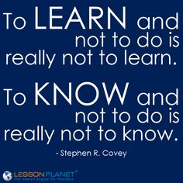
It is no longer enough to know...
….students must be able to do

Slide 3
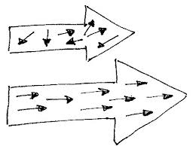
What students must be able to do...
Standards-based report cards K-8
Vertical Teams and alignment 6-9
High School Curriculum alignment

Slide 4
Standards Based Reporting
Elementary (K-4) and Intermediate (5-6)
Grade-level meetings, Report Card expectations
“Bottom Lines”
Bridges Math Program K-5
Teachers College Partnership

Slide 5
Standards Based Mindset
Ellington Middle School (Grades 7-8)
“Read,Talk,Reflect,Try”
“Small Conversation before Large Conversations”
“Practice before Policy”

Slide 6
Standards Based Mindset
Handouts
Standard Based Report Card
Trimester Expectations
EMS Grading Practices
Report Card Timeline

Slide 7
Standards Based Mindset
Ellington Middle School (Grades 7-8)
“Read,Talk,Reflect,Try”
“Small Conversations before Large Conversations”
“Practices before Policy ”

Slide 8
Vertical Teams and Alignment across grades
How we’re working on it
6-8 Science Team
NGSS
Report Cards
Middle School/High School Math
Algebra 1
Math Support & Intervention
Middle School/High School World Language

Slide 9
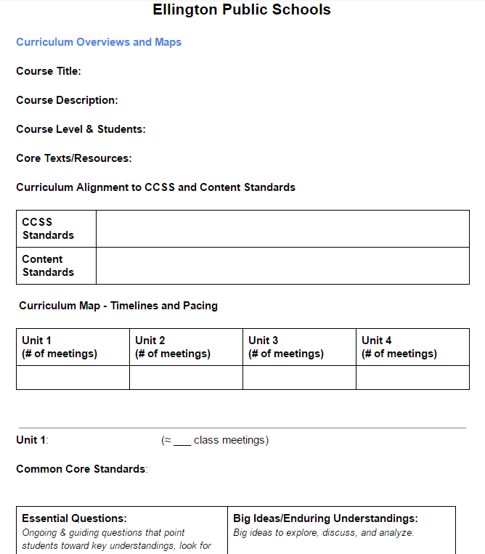
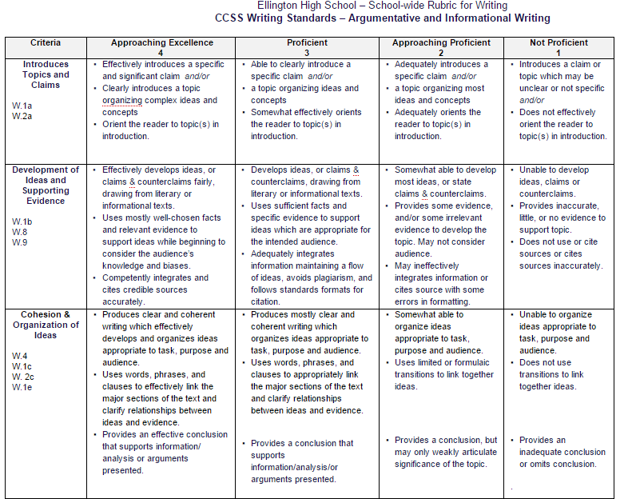
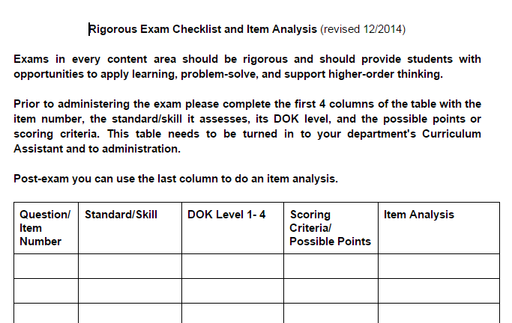
Aligning our practice and the standards
High School
Summer Work
revised Curriculum Template
revised school wide rubrics
Winter 2015
revised Rigorous Exam Checklist

Slide 10
Students must do...
...and at varying levels of complexity
Bloom's Webb's Hess's ?

Slide 11
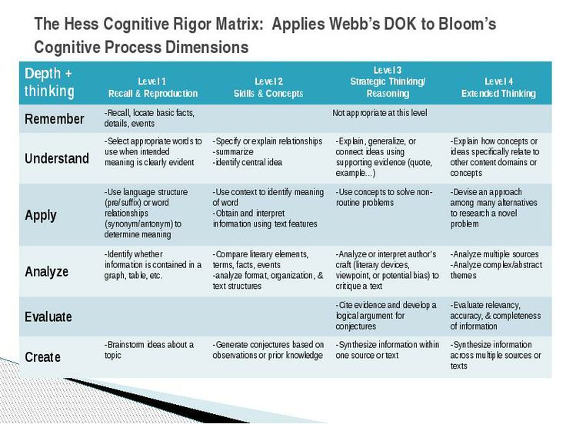
Teaching Teachers
“The quality of a question is not judged by its complexity but by the complexity of thinking it provokes.”
-Joseph O’Connor

Slide 12
How we are doing it...
High School Special Faculty Meeting (12/14)
Administration review of midterms
Feedback and support for teachers
High School Special Faculty Meeting (1/15)
PLG’s
Student Schedule “Audit”

Slide 13
In order for students to know and do...
...teachers must design/assign tasks that meet the intent of the standards
CCSS
Content Practices and Frameworks

Slide 14
Teaching Teachers
Professional Development across content areas
Data Driven Decision Refresher for CA’s
Protocols
Item Analysis
Task Deconstruction
Looking at Patterns in Student work
ATLAS
Special Faculty meetings
PLG’s

Slide 15
Teaching Teachers
Professional Development in specific content areas
Social Studies
English
Math
Science
Technology Education

