Slide 1


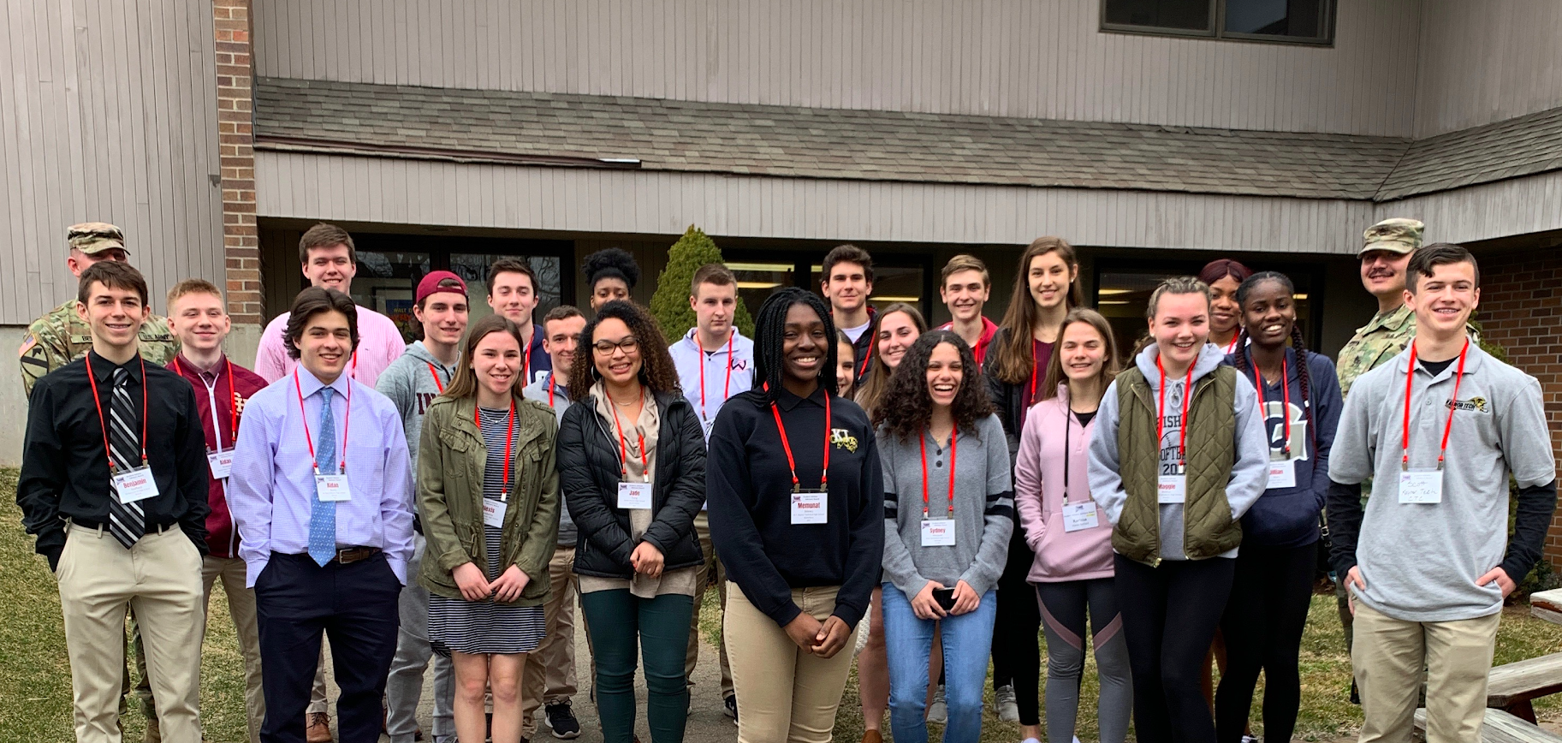
STUDENT ATHLETIC
ADVISORY BOARD
CAS-CIAC is excited to announce the fourth year of the Student Athletic Advisory Board. An offshoot of the successful “Class Act Schools” initiative, the statewide advisory board empowers students to promote good sportsmanship within their leagues and to address other issues regarding athletics.
In addition, students will be able to share their respective experiences and highlights so that they can learn from each other and take great ideas back to their own leagues. Students will now have a voice to promote and improve respect, teamwork, and character in all of our Class Act schools and beyond.
Selections should be made by athletic directors, principals, and league commissioners, and then sent to
Cherese Miller at cmiller@casciac.org
by September 27, 2021.
Purpose
Educate students, staff, parents and spectators on what the expectations are for a Class Act School
Voice all concerns dealing with athletics within the different schools
Have dialogues about the positive aspects of athletics and brainstorm ways to make it even better
Develop and implement ideas for promoting good sportsmanship state wide
Students
The SAAB will consist of 4 students from each league
    4 students with each student representing a different school within the league
Student requirements
  Complete an application provided by CAS-CIAC
    Write a letter of interest
    Submit a recommendation letter from a teacher, coach, or any staff member
Meetings
Three meetings a year typically take place at the CAS-CIAC central office in Cheshire in October, January, and April. For the 2020-21 school year, meetings will be virtual until further notice.

Slide 2
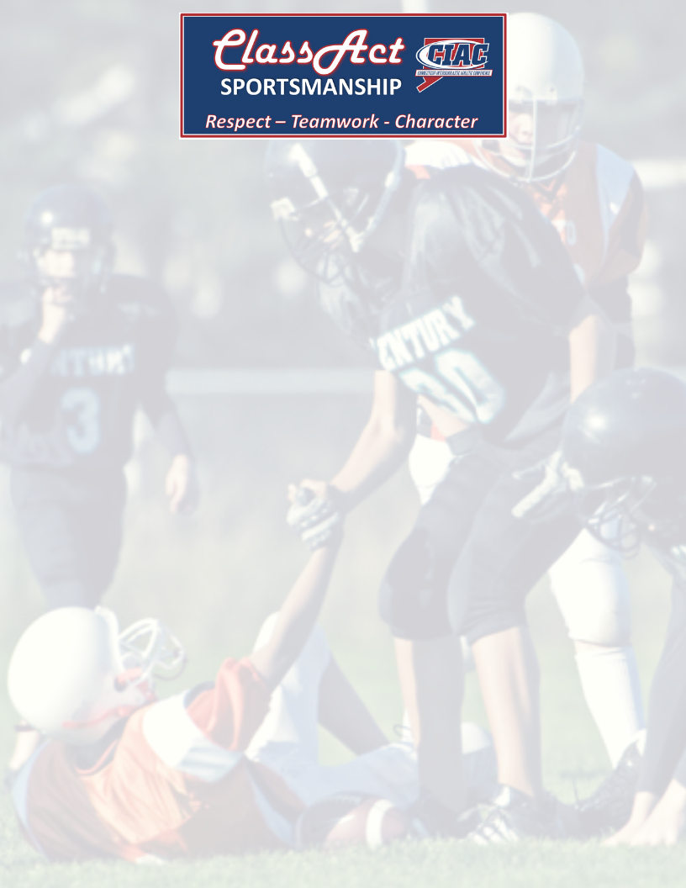
Berkshire League
The Gilbert School, Winsted
Housatonic Valley Reg. High School, Falls Village
Nonnewaug High School, Woodbury
Northwestern Regional High School, Winsted
Shepaug Valley High School,Washington
Capital Region Athletic League
Academy of Aerospace & Engineering (AAE), Windsor
Academy of Science & Innovation, New Britain
Achievement First Charter High School
Metropolitan Learning Center (MLC), Bloomfield
Capital Preparatory High School, Hartford
Civic Leadership, Enfield
Classical Magnet School, Hartford
Parish Hill High School, Chaplin
University High School of Science and Engineering
Central Connecticut Conference
Avon High School
Berlin High School
Bloomfield High School
Bristol Central High School
East Catholic High School, Manchester
Enfield High School
Glastonbury High School
Lewis Mills High School, Burlington
Manchester High School
Middletown High School
New Britain High School
Newington High School
Plainville High School
Platt High School
Rocky Hill High School
Simsbury High School
Southington High School
Tolland High School
Connecticut Technical Conference
A.I. Prince Tech. High School, Hartford
Henry Abbott Tech. High School, Danbury
Harvard Ellis Tech. High School, Danielson
E.C. Goodwin Tech. High School, New Britain
Ella Grasso Southeastern Tech. High School, Groton
W.F. Kaynor Tech. High School, Waterbury
Norwich Tech. High School
Emmett O'Brien Tech. High School, Ansonia
H.C. Wilcox Technical High School, Meriden
Howell Cheney Technical High School, Manchester
Platt Tech. High School, Milford
Vinal Technical High School, Middletown
Windham Tech. High School
Oliver Wolcott Tech. High School, Torrington
J.M. Wright Technical High School, Stamford
Eastern Connecticut Conference
Bacon Academy, Colchester East Lyme High School Robert E. Fitch High School, Groton Griswold High School Killingly High School Ledyard High School Lyman Memorial High School, Lebanon New London High School Norwich Free Academy Putnam High School Saint Bernard School, Uncasville Stonington High School Tourtellotte Memorial High School, No. Grosvenordale Waterford High School Wheeler High School, North Stonington Windham High School Woodstock Academy
Fairfield County Interscholastic Athletic Conference
Brien McMahon High School, Norwalk
Norwalk High School
St. Joseph High School, Trumbull
Stamford High School
Staples High School, Westport
Westhill High School, Stamford Wilton High School
Naugatuck Valley Conference
Derby High School
Holy Cross High School, Waterbury
Sacred Heart High School, Waterbury
Seymour High School
St. Paul Catholic High School, Bristol
Torrington High School
Wolcott High School Woodland Regional High School, Beacon Falls

Slide 3
North Central Connecticut Conference
Canton High School
Classical Magnet School, Hartford
Coventry High School
East Windsor High School
Granby Memorial High School
Somers High School
Stafford High School
Suffield High School
Shoreline Conference
Coginchaug Reg. High School, Durham
Cromwell High School
East Hampton High School
Haddam-Killingworth High School, Higganum
Nathan Hale Ray High School, E. Haddam
The Morgan School, Clinton
North Branford High School
Old Lyme High School Old Saybrook High School
Portland High School
Valley Reg. High School, Deep River
Westbrook High School
South Western Conference
Bethel High School
Brookfield High School
Bunnell High School, Stratford
Immaculate High School, Danbury
Joel Barlow High School, Redding Kolbe-Cathedral High School, Bridgeport Masuk High School, Monroe
New Fairfield High School
New Milford High School
Newtown High School Notre Dame Catholic High School, Fairfield Pomperaug High School, Southbury
Stratford High School
Weston High School
Southern Connecticut Conference
Amity Reg. High School, Woodbridge
Branford High School
Cheshire High School
Daniel Hand High School, Madison
East Haven High School
Fairfield Preparatory
Joseph Foran High School, Milford
Jonathan Law High School, Milford
Academy of Our Lady of Mercy - Lauralton Hall, Milford
North Haven High School
Sheehan High School, Wallingford
Shelton High School
West Haven High School

