Slide 1
Using Universal Screening to Identify Students in Need of Tier 2 and Tier 3 Mental Health Interventions
Peg Donohue, PhD Kathleen Bai
Linda Romanchok Erica Mastronardi
Karyn Hester
June 23, 2017
CAS/CABE
Summer Institute
Notes:
Peg

Slide 2
Please answer: This would be a great workshop if….
Notes:
Peg

Slide 3
1. What is universal screening (US)?
2. Why is it encouraged in schools?
3. What is involved?
4. What would a US pilot look like?
5. How does a team select an instrument?
6. What does the data tell us?
7. How do districts use the data over time?
Notes:
Linda

Slide 4
What do we currently do, to screen all students?
Notes:
Linda

Slide 5
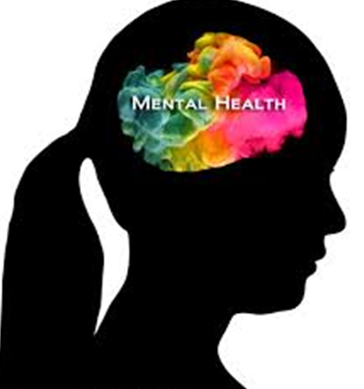
What about…
Notes:
Linda

Slide 6
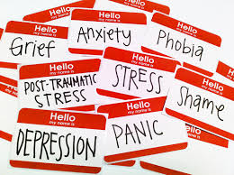
Identification & Treatment
Each year, 14-20% of youth are diagnosed with mental, emotional, or behavioral mental health disorders (National Academy of Science, 2009)
Only 45% of youth with a mental health diagnosis receive treatment, and only 24% of those individuals receive care in the school system (Costello, He, Sampson, Kessler, & Merikangas, 2014).
Notes:
Peg

Slide 7
Mental Health Status of Children in 2016
1 in 5 children suffers from a mental health or learning disorder, and 80% of chronic mental disorders begin in childhood. There is an urgent need to identify the signs of these conditions early in life if children are to get the care and support they need to thrive. (Merikangas, et al., 2010)
Child Mind Institute. 2015 Children’s Mental Health Report. Retrieved from http://www.speakupforkids.org/report.html
Notes:
Peg

Slide 8
Stress in Childhood
Approximately 1/3 of children display symptoms of stress
More than half of all college students report “overwhelming anxiety”
“Stress is the top health problem facing kids today.”
Sandra Hassink, Former President American Pediatrics Association
Notes:
Peg

Slide 9
Childhood and Adolescence is the time to intervene
Kessler R.C., Berglund P., Demler O., Jin R., Merikangas K.R., Walters E.E. Lifetime Prevalence and Age-of-Onset
Distributions of DSMIV Disorders in the National Comorbidity Survey Replication. Arch Gen Psychiatry.
2005;62(6):593-602. doi:10.1001/archpsyc.62.6.593
Notes:
Peg

Slide 10
Mental health and school age children
Internalizers are underserved by special education and mental health systems
Source: Bradshaw, Buckley, & Ialongo, 2008
Notes:
Peg

Slide 11
Internalizing behaviors: directed inward, including depression, anxiety, phobias, social withdrawal, and peer isolation (Forns, Abad, & Kirchner, 2014).
Externalizing behaviors: directed to the environment and others: aggression and rule breaking (Forns, Abad, & Kirchner, 2014).
Notes:
Linda

Slide 12
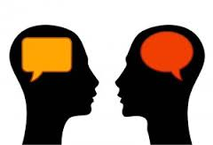
Turn and talk
What trends are you seeing in your district?
What are kids presenting with?
How do you know?
Do you know how many mental health crisis calls (211) your district made this past year?
Notes:
Linda

Slide 13
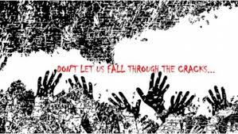

Slide 14
Universal Screening Defined
Universal Screening is defined as:
“The systematic assessment of ALL children within a given class, grade, school building, or school district on academic and/or social-emotional indicators that the school personnel and community have agreed are important.”
(Ikeda, Neessen & Witt, 2008, p. 113)
Notes:
Peg: adding SEL to screening

Slide 15
Child-Find
Defined in the Individuals with Disabilities in Education Act (IDEA):
School district personnel have the legal responsibility to ensure that all children within their jurisdiction, birth to 21, regardless of the severity of their disability, and who need special education and related services are identified, located, and evaluated.
Notes:
Kathy

Slide 16
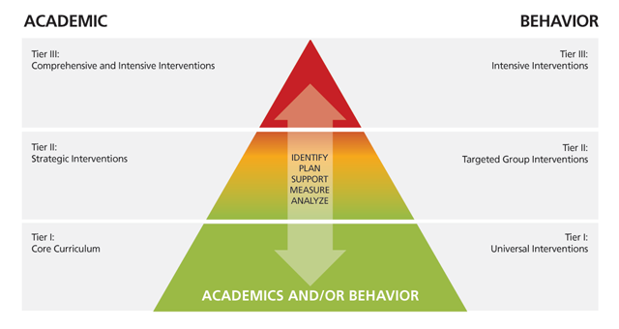
Two sides of the triangle
Notes:
Kathy

Slide 17
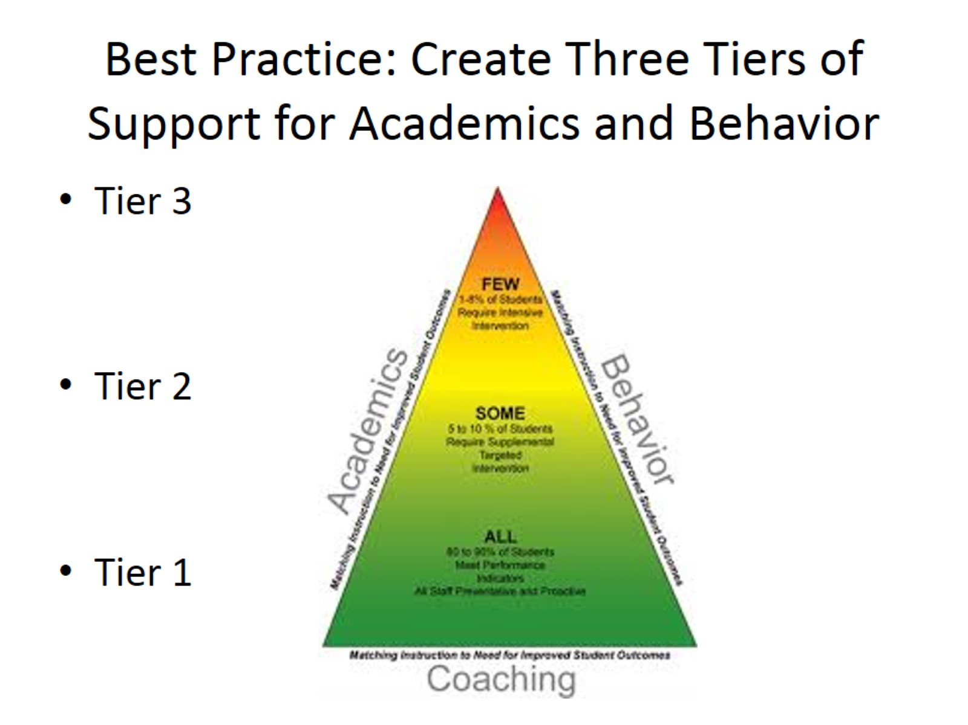
Best Practice: Create Three Tiers of Support for Academics and Behavior
RTI+ PBIS = MTSS
Notes:
Kathy: systemic tiers of intervention prior to formal SPED process

Slide 18
US Fits with District Goals
Create and implement shared beliefs and systems that support students’ social and emotional wellbeing, improve school climates and support ongoing growth in relationships.
Review and identify educational practices that contribute to student mental health concerns; change adverse practices so as to minimize mental health issues.
Build acceptance and support amongst parties for opportunities for children to develop conflict resolution, resiliency, coping and independence skills.
Notes:
Kathy

Slide 19
Benefits of early intervention
Early intervention leads to better outcomes
Students confront increasing academic demands
We have to address mental health concerns so students are available for learning
Hard wire kids with coping skills early in their lives
Notes:
Kathy

Slide 20
How do we serve all the kids we identify?
Created of Collaborative Services Team in 2009
Strong partnership with Youth and Family Services Agency
Joined previously existing counseling groups
Interns supporting Tier 2 from YFS and OSMS
Parent provided counseling
Notes:
Kathy

Slide 21
Piloting Universal Screening
Notes:
Peg

Slide 22
Universal Screening Process
School team selects a screening instrument, ensuring fit for school district and students
Decide process, communicate with families, train staff
Collect & analyze data
Provide/coordinate interventions for identified students
Assess again
Notes:
Peg

Slide 23
Notes:
Peg

Slide 24
Universal Screening recommended by:
2002 The United States President’s Commission on Excellence
in Special Education (U.S. Department of Education OSERS)
2009 National Association of School Psychologists (NASP)
2009 National Research Council
2009 Institute of Medicine
2013 A Framework for Safe and Successful Schools
2014 Connecticut Office of Child Advocate (2014)
2016 CSCORE research brief 11.1: Humphrey, N. & Wigelsworth, M.
Making the case for universal school-based mental health screening.
2017 Ohio PBIS Network

Slide 25
Why add universal screening to our practices?
“Schools must play a critical role in the identification and referral of students with social, emotional, and behavioral health problems. This identification and referral is critical to ensure that students are then connected with the appropriate supports both in the school and in the home… The goal of interconnection between separate systems within the mental health arena can only be successfully achieved through the integration of schools and their active participation concerning the mental health and wellness of their students.”
(Office of the Child Advocate, 2014, p.92)
Notes:
Peg

Slide 26
What are common screeners used in schools?
Name | Age Levels | Description
Systemic Screener for Behavior Disorders (SSBD), 2014 | 3-12 Years | 3 stage process from perspective of the teacher via rating scales and observations. Screens for internalizing and externalizing behaviors.
Strengths and Difficulties Questionnaire (SDQ), 2002 | 4-17 Years | Teacher, parent, or student report. 25 item screener measures for internalizing, externalizing, and prosocial behaviors.
Social Skills Improvement System (SSIS) Rating Scales, 2008 | 3-18 Years | Teacher, parent, or student administered. Screens for Social Skills, Problem Behaviors (e.g. Externalizing, Internalizing), and Academic Competence.
Behavior Assessment System for Children 3: Behavior and Emotion Screening System (BASC-3 BESS), 2015 | 3-18 Years | Teacher, parent or student administered. Screens for internalizing and externalizing problems, school problems, and adaptative skills. 25-30 items.
Beck Youth Inventories, Second Edition (BYI-2), 2005 | 7-18 Years | Self-reported evaluation of children’s and adolescents’ emotional and social impairment. 5 potential inventories with 20 questions each; Anxiety (BAI-Y), Depression (BDI-Y), Anger (B, Disruptive Behavior, and Self-Concept.
Notes:
Karyn
Selecting right screener for your school district:
Appropriateness for intended use or validity for intended purpose (at-risk, anxiety, depression), developmental, frequency of screeners
Adequate norming sample – demographic and geographic representation, year of norming population, 100+ per age group, ethnic, and publication data for relevance to today’s youth.
Usability/practicality – administration time, purchase cost, ability to provide services, and informs interventions
BESS, SSIS, SDQ have a spanish version.
SSIS $120 Manual plus protocols (hand score)
BESS $333 Manual plus protocols (hand score)
BYI $260 all 5 manuals or $60 each plus protocols (hand score)
SSBD $250 manual plus protocols
SQD paper version free.
Teacher form – limited student knowledge – only in school behavior, short period of interaction; to be used in conjunction with parent and/or student form

Slide 27
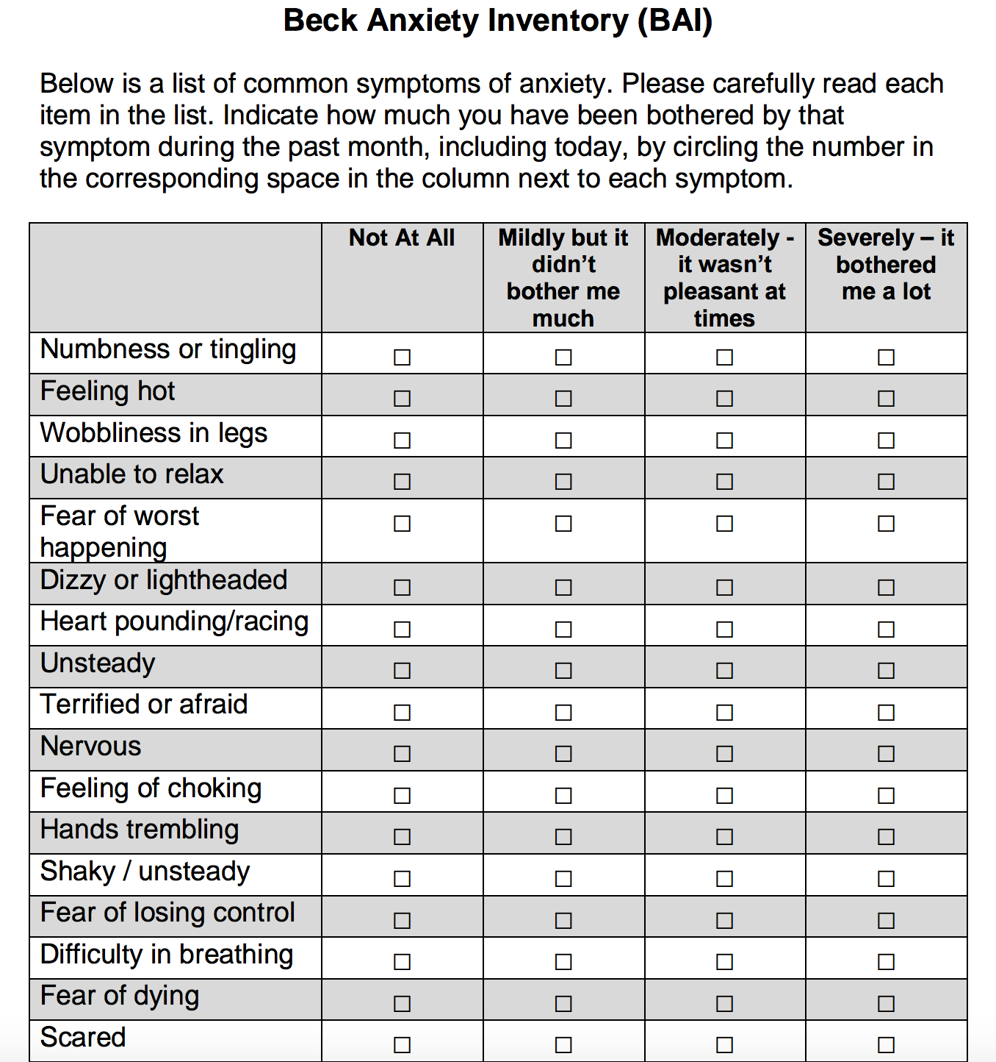
Sample questions from the BAI

Slide 28
Notes:
Kathy

Slide 29
Standardization of administration
Small groups
Protocols were read to the students
Administered by school counselors and school psychologist
Notes:
Linda

Slide 30
Informing Parents
Called home
Sent letters
Only informed teachers with parent permission
Gave school based mental
health team an opportunity
to partner with parents
Notes:
Linda

Slide 31
Notes:
Kathy

Slide 32
Behavioral and Emotional Screening System (BESS) (Kamphaus & Reynolds, 2007)
Developed as a school-wide (Universal) screening tool for children in grades Pre-K to 12
Similar to annual vision/hearing screenings
Identifies behavioral and emotional strengths and weaknesses
Externalizing behaviors (e.g., acting out)
Internalizing behaviors (e.g., withdrawn)
Adaptive skills (e.g., social and self-care skills)
Notes:
32
Karyn

Slide 33
Parent Form
Notes:
Karyn

Slide 34
Training needed to administer the screeners
Individual requirements
I.e.: BASC2: must have a masters degree and appropriate training in fields of either counseling, school psychology, marriage and family therapy or social work.
Importance of collaboration to administer and score protocols
Notes:
Karyn

Slide 35
Data based decision making – changing instruments
BASC 2 – original instrument
Needed a clearer picture of who was struggling with anxiety
Beck Inventory was better
Are we missing kids who have depression?
No screener is perfect
Notes:
Linda

Slide 36
Findings from new instruments
Moved to Beck Inventory
Scored by hand
Benefits
Drawbacks
What did the data tell us?
Notes:
Linda

Slide 37
Another way to look at the data
(Lane, 2016)

Slide 38
Looking at the data

Slide 39
Allocating Resources – One Size Fits All?
School | Population | % Elevated | # School Psychologists | # School Counselors | # Behavior Therapists
A | 500 | 54 | 1.5 | 2 | .5
B | 500 | 25 | 1.5 | 2 | .5
C | 500 | 36 | 1.5 | 2 | .5
D | 500 | 20 | 1.5 | 2 | .5
2
0 1
6
Data-based decision making to allocate or add resources
School | Population | % Elevated | # School Psychologists | # School Counselors | # Behavior Therapists
A | 500 | 54 | 2 | 3 | 2
B | 500 | 25 | 1.5 | 2 | .5
C | 500 | 36 | 2 | 3 | 2
D | 500 | 20 | 1.5 | 2 | .5
2
0 1
7

Slide 40
Combine screener with other data
(Lane, 2016)

Slide 41
Cost benefit analysis of universal screening
Notes:
Kathy

Slide 42
What were we able to accomplish?
“There were three important outcomes of introducing universal screening in our district:
We identified kids we didn’t know needed help.
We introduced mental health into the general educators’ conversation in a concrete and understandable way.
We encouraged our school based mental health teams to work even more collaboratively to identify and meet the needs of students.
These are things we have been trying to do, with limited success, for years!”
Notes:
Kathy

Slide 43
School-Based Mental Health Staff: Unique and Overlapping Skill Sets
School
Counseling
School Based MFT
Best Practice: All of these
specialists would collaborate with
teachers and administrators to
initiate universal screening
in your district
Necessary Redundancies
School Psychology
School Social Work
Notes:
Peg

Slide 44
Turn and talk
Who do you have on your team?
Who can you call on in a time of crisis?
Who would you like to add to your team?
Notes:
Peg

Slide 45
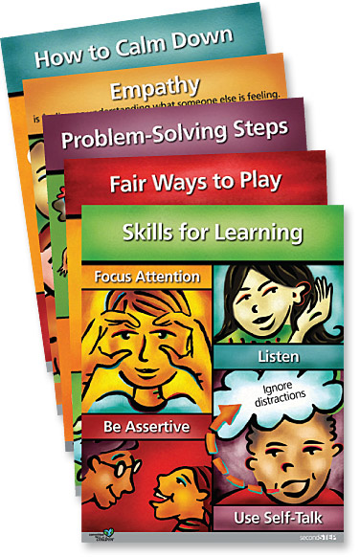
Meeting identified students’ needs
Create Tier 2 groups
using evidence based
interventions
Notes:
Linda

Slide 46
Tier 2 – Utilizing Evidence-Based Interventions 75% of all mental health services received by children and youth occur in schools. (Shinn & Walker, 2010)
Anxiety
Coping Cat by Philip Kendall, PhD (2006)
Ages 7-13 Years; or C.A.T. Project for 14-17 Years
Group or individual
$47 Manual & Workbook
Psychoeducational and skill building program
Recognizing and understanding emotional and physical reactions
Clarifying thoughts and feelings and anxious situations
Developing plans for effective coping
Evaluating performance and giving self-reinforcement
FEAR Plan
F - Feeling Frightened?
E - Expecting Bad Things to Happen?
A - Actions & Attitudes That Can Help
R - Results and Rewards
Notes:
Karyn
Selecting an evidence-based intervention to address the social-emotional needs – like, cognitive-behavior approach, interpersonal approach to build relationships and connections, problem-solving skill training, and social skills training.

Slide 47
Tier 2 – Utilizing Evidence-Based Interventions
Depressive Symptoms
Taking ACTION by Kevin Stark, PhD & Philip Kendall, PhD (1996)
Cognitive-behavioral approach focusing on changing student’s affect, thoughts, and behaviors; psychoeducational component and teaches coping skills, problem-solving, interpersonal skills and positivity.
9-18 years old
Gender specific group sessions or individual
$46 Manual & Workbook
“Helping Students Overcome Depression and Anxiety” by Kenneth W. Merrell, PhD (2008)
Focus on education of depression/symptoms/emotions, cognitive restructuring, problem-solving, pleasant activity scheduling, relaxation training, and social skills training. Based on Cognitive therapeutic approach by Aaron Beck.
Adolescents
Group or Individual
$37 Manual
Notes:
Karyn
Age of students within 2 years of one another

Slide 48
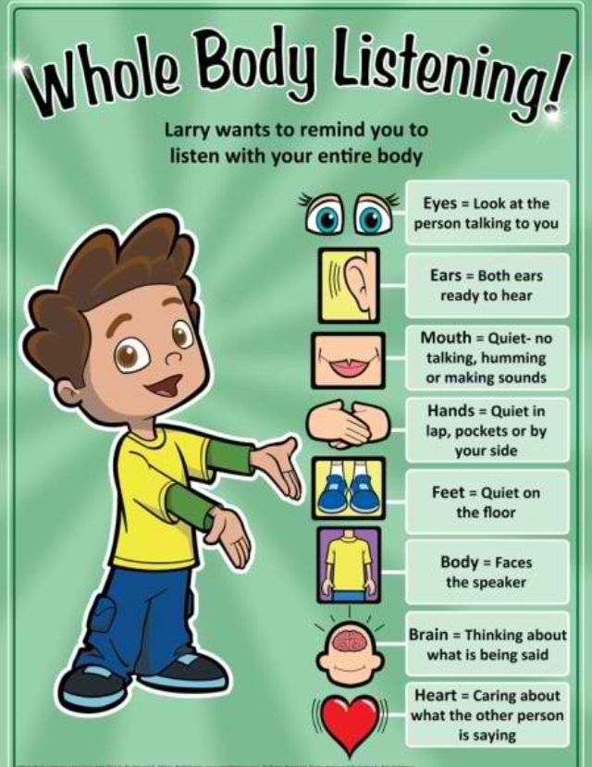
Whatever interventions you choose - make sure to implement with fidelity!
Notes:
Erica

Slide 49
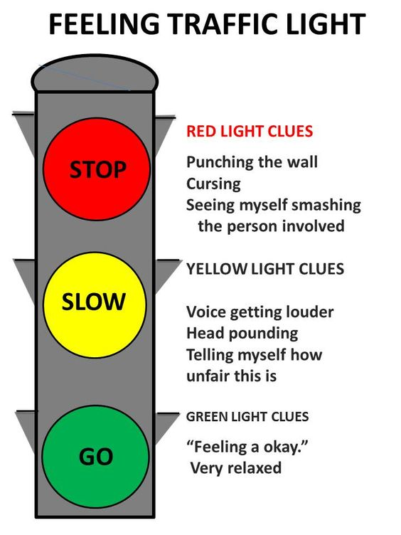
Create Tier 2 Intervention Kits
Includes:
Information about the area of concern
Pre-post assessments
Progress monitoring sheets
6-10 lessons to teach specific skills
Student worksheets
Data can be shared with site consult team
to decide if intervention is working
INTERNS CAN HELP WITH THIS!
Notes:
Erica

Slide 50
Parent Seminar on Anxiety
Held Parent Night entitled “Anxiety in Kids and Teens: An Informational Overview and Recommendations for Parents and Guardians”
Forum to share information and resources
Followed with an article in Saybrook Events
Outcome-Increased communication between school and home
Next Steps
Notes:
Kathy and Linda

Slide 51
Brainstorm with a partner
What would be the benefits of initiating universal screening in your district?
What are the constraints or barriers you think you might encounter?
Notes:
Kathy

Slide 52
Benefits of Universal Screening
1. Prevention: early identification, earlier intervention, better outcomes
2. Data-driven
3. No one falls through the cracks
4. Promotes collaboration: team coordinates and supports students
5. Increases sensitivity of educational staff
6. Changes culture: normalizes mental health; if you measure it – it matters
7. Can be implemented within PBIS/MTSS
Notes:
Peg
Collaboration with parents improved

Slide 53
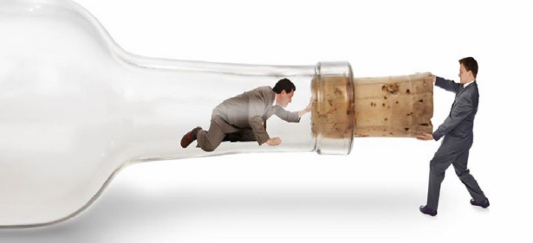
Constraints
1. Cost (time and money)
2. Make sure leadership understands benefits of US
3. How do we meet identified students needs?
4. Linear thinking – siloed thinking – need systems thinker
5. Both wealth and poverty insulate children from mental health services
6. Stigma connected to mental health
7. Ensure students aren’t profiled; is assessment demographically appropriate?
8. Survey fatigue
Notes:
Peg

Slide 54
Mental Health = Health
Notes:
Peg

Slide 55
Central Connecticut State University Center for Social and Emotional Learning
Training – Research – Best Practices
in Fostering SEL Across the Lifespan

Slide 56
Another Resource
https://www.pbis.org/media/videos
Notes:
Peg

Slide 57
Peg Donohue peg.donohue@ccsu.edu
Kathy Bai kbai@oldsaybrookschools.org
Linda Romanchok lromanchok@oldsaybrookschools.org
Erica Mastronardi erica.mastronardi@my.ccsu.edu
Karyn Hester hesterk1@southerct.edu

