Slide 1
Building Capacity of the Professional Staff to Support Social Emotional Learning in a PreK-1 Learning Environment
Presented by Killingly Public Schools

Slide 2
Killingly, CT
Killingly is a semi-rural community and is part of the Quiet Corner of Northeastern CT with a population of approximately 17,000 residents
Our school district is comprised of approximately 2,600 students that attend grades Pre-K to 12.
Our current 2016 district four-year graduation rate is 80%
Our district school improvement plan is committed to:
            1. High quality curriculum/assessment
            2. Providing opportunities for high quality professional development to ensure implementation of effective strategies linked to student achievement
            3. A professional learning community that collaborates to integrate and adjust needs based instruction to meet the academic, social, and emotional needs of every student

Slide 3
Background and Conditions for Change
August 2014 – Full Day Kindergarten is implemented in the district
August 2015 – Reconfiguration of two elementary schools: Converted two K-4 buildings to a Prek-1 Building and a 2 – 4 Building Awarded Preschool Development Grant – Increased program by 20% for at-risk students
August 2016 – Hired 25% new certified staff, transitioned 10% of the staff into new roles, hired 30% new administrative staff.
Notes:
36 seats
Impact: PD, climate, assimaltions
Three new prinicpals two interims.

Slide 4
Now what?
Problem of Practice: Many of our youngest learners were presenting significant social and emotional behaviors that were negatively impacting their learning. The 2015-16 school presented an increase in the amount of dysregulated students resulting an increase in crisis calls, special education referrals, and out-of-district placements. The district recognized a need to further support the Social/Emotional well-being of each child. It was decided that in order to implement change there would be three ”avenues” to be explored:
  High Quality Early Childhood Programming through the P-3 Leadership Program sponsored by the NEAG School Of Education and the OEC
  Purposeful Play- A mindset that deepens learning related to 21st Century Learning Standards, fosters social -emotional development, and promotes executive function and self-regulation strategies
  Developmental Teaching of Responsible Behavior- A 3-year term of professional learning with teachers facilitated by Vivian Batterson of Eastconn
Notes:
Leveraging Grant Funding- PDG Grant - Preschool Grant utilized to bridge Kindergarten Professional Development- this allowed for shared professional learning opportunities around SEL
KCS Impact: The reconfiguration brought in many challenging behaviors in a single location. A significant impact on supporting students. Examples were cafteria. Recovery from dysregulation takes longer. Many models of negative behaviors.
The increase of 36 students at GECC of at-risk students. 1st year all togeet

Slide 5
Our Beliefs in Killingly for Our Youngest Learners….
We can, whenever and wherever we choose, successfully teach all students whose schooling is of interest to us. We already know more than we need in order to do this. Whether we do it must finally depend on how we feel about the fact that we haven’t so far.
Ron Edmonds, Effective Schools for the Urban Poor,
Educational Leadership, October 1979, pg.23
Notes:
Be prepared to address the fact that we knew what we needed and didn’t do it. Did we have the capacity to do it, time was a actor

Slide 6
Social, Emotional, and Behavioral Competence in Young Children
Preschool Development Grant (PDG) used professional development funding to bring in outside consultants for the school years 2015-2018.
Objective: Develop a deeper understanding of developmental stages of social/emotional/behavioral skills in children aged 3- 5, toxic stress and its impact on development, and neuroscience. What to do when all the other tools in your toolkit are not working.
Target Audience: Preschool & Kindergarten Certified Staff
Notes:
Sally Slide
- speak to the impact of the grant on the student population. We were welcoming at-risk students. We addressed PD to meet those needs , and brought in K staff
Year 1
Year 2 – content – Compassion fatigue, the supports were for adults

Slide 7
Social, Emotional, and Behavioral Competence in Young Children (cont.)
Process: Three year commitment, 4 days per year of professional development with follow up in between.
Impact: Aligned approach, preventative strategies, self- assessment on tiers 1,2,3. Asking the question, “Why does this child act this way?” Using a developmental framework to address concerns.
Next Steps: Designating who will carry on the work, sharing information with first grade and paraeducator staff, building the tools we’ve learned about into our SRBI process, and partnering with community agencies
Notes:
Sally

Slide 8
“The Vivian Project” – Year 1
Foundational learning around …..
    Basic Needs: food, shelter, clothing, emotional safety
    Fight, flight, or freeze response
    Neuroscience
    Conflict Cycle and our role in it
    Resiliency
    Circle of Courage: Generosity, Belonging, Mastery, Independence
    Teachers are asked to think about 1-2 students in their class and complete an SEB screening. Problem solve as a group.

Slide 9
“The Vivian Project” – Year 2
Dig deeper into content and do more application.
Social Power: Expertness, Coercion, Manipulation, Likeability
Developmental Stages of Young Children
              Stage 1: Birth to Two Respond to the environment with pleasure
              Developmental Anxiety: “No one cares.”
              Stage 2: Respond to the environment with success, please adults
              Developmental Anxiety: “I can’t do anything right.”
              Stage 3: Successful Group Participation
              Developmental Anxiety: Guilt over failure to meet expectations.

Slide 10
“The Vivian Project” – Year 2 (cont.)
Dig deeper into content and do more application (cont.).
Collaborative Problem Solving Approach using Developmental Teaching model
Self-Assessment
Administering the DTORF
Building practices and alignment
Compassion Fatigue
Plan for gradual release of responsibility

Slide 11
“The Vivian Project” – Year 3
Goal: All preschool and kindergarten teachers, as individuals and/or as members of a team, possess the knowledge, understanding, skills, and structures necessary to successfully foster SEL along the prevention-intervention continuum without the presence of an outside consultant.
    What will it look like, feel like, and sound like at Goodyear and KCS?
                - Identify and support our own Consultants.
                - Share this information with others.
                - First 6 weeks of school, activities that teach generosity, mastery, independence, & belonging.
                - Use regularly as part of our Tier 1-3 strategies.

Slide 12
PK-3 Leadership Program
A team of 3 was sent to bring back learning around what High Quality Early Childhood Education looks like, this team included the building principal from our Preschool Center, the building principal from our early elementary school (PK-1), and our instructional coach that works in both settings across preschool and kindergarten.
Research in early childhood development shows that investments in quality early childhood education programs produce lifelong benefits for children.
Proper alignment of curriculum, instruction, and assessment during PreK-3rd grade is linked to improved outcomes for children through grade 12. And quality early learning experiences help close opportunity and achievement gaps.
The Connecticut PK-3 Leadership Program has been specifically created to help
school principals, central office and other administrators, lead teachers, community directors, and superintendents bring new skills and leadership to their school districts.
Notes:
Heidi
Mention the grant to support the PD

Slide 13
Goals of the Program
Plan systemically with a growth mindset, including all stakeholders, to improve coherence and quality of early learning based on a comprehensive PreK-3rd grade approach.
Observe classroom instruction to identify quality indicators as well as practices that interfere with learning.
Lead toward reduced achievement gaps and socially just classrooms.
Clearly and credibly communicate strategies and benefits to diverse stakeholders.
Notes:
Heidi

Slide 14
Goals of the Program (cont.)
Three Modules were provided during the program over the course of the year. Each module was broken down into target areas:
  Curriculum and Instruction
  Assessment Practices with Young Children and Evaluation of Teachers and Programs
  Leading for Equality, Excellence an Early Success

Slide 15
Curriculum and Instruction (Module 1)
Focus Areas:
Aligned and integrated PreK-3 standards, specifically: K-3 Social and Intellectual habits along side ELDS-Social/Emotional Development: Looked closely at how the Early Learning Standards and Common Core meet across Domains
Learning environment/Intentional teaching- Expert speakers and visits to model schools to understand best practice in an environment that inspires learning
Brain research/child development- Newest researched shared to better understand childhood adversity, trauma, and neuroscience
Outcomes:
                Timing: Of instruction matters, intervention beginning with our earliest learners
                Quality: Intentional and purposeful instruction with a strong focus on SEL
                Dosage: Day to day- utilizing full day vs. half day and looking at attendance over time- cumulative longevity
Notes:
Heidi

Slide 16
Assessment/Leadership (Module 2/3)
Assessment:
Formative/Summative/Authentic- Balanced and Appropriate measures
Quality Indicators- how to look at the program as a whole
Teachers: SEED/ CLASS rubrics
Leadership:
School Climate and Professional leadership learning capacity
Partnering with Community and Family
Notes:
Heidi

Slide 17
Biggest Takeaways
Expert panel:
Juanita Copley, E. Aschenbrenner, Dr. Sharon Ritchie, Dr. Steven Tozer
Visits:
Riverside Magnet School at Goodwin College, East Hartford
Charter Oak International Academy, West Hartford
New Language:
Developmentally Effective vs. Developmentally Appropriate
Goals to strive for when setting high expectations:
Creating a collective impact as a District sharing a common agenda for Early Childhood, using shared measures that speak the same language, striving for continuous communication between schools, families and community
Notes:
Heid

Slide 18
What’s Next?
“Every Child, Every Grade, Every Day”
What do children need in an early childhood setting?
Using the following framework our District will move forward with a P-4 Committee to work of these areas:
Mission/Vision- Create a unified mission and vision for preschool through grade 1 reflecting belief of Early Childhood Experts
Alignment- Align across grades: curriculum, frameworks, assessment practices, schedules, and behavioral practices
Purposeful Play:
-
Notes:
Heidi

Slide 19
What’s Next?
“Every Child, Every Grade, Every Day” (cont.)
Professional Learning- Creating a shared capacity and collaborative climate that is shared vertically
Student Climate and Environment- Promoting purposeful play, executive function and regulation strategies alongside an environment that engages child centered inquiry and collaboration
Family and Community Engagement- Expanding upon current practices to encompass all families and link community resources
Assessment/ Evaluation of steps taken in the process through survey information across stakeholders
Notes:
Emily

Slide 20
Purposeful Play
Student Climate and Environment-
2015/2016 presented an increase in dysregulated behavior. Reflection began!
PreK-1 setting: Reader’s and Writer’s Workshop Model, Go Math!, and Science but where is the play?
Research behind play:
Symbolic thinking
Self-regulation
Cognitive flexibility
Social skills
Social-emotional competence
Science and Social Studies concepts
Notes:
Emily

Slide 21
Play Benefits, continued
Supporting Executive Function, Language, Literacy, and Mathematical Thinking
A recent federally funded large scale randomized controlled trial was conducted by researchers at New York University. The findings from Massachusetts kindergartens in 29 districts confirmed the positive impact of specific strategies to address executive function embedded in language, literacy, mathematics and science learning. Results demonstrated the positive impact to working memory, reasoning ability, mathematics, control of attention, and levels of cortisol. Reading and vocabulary at the end of kindergarten increased into first grade. A number of effects were largest in high poverty schools. (Blair and Raver, 2015)

Slide 22
Discovery Time!
6 Teachers were selected to become Play Ambassadors-Train the Trainer approach
Full day professional development with Elizabeth Aschenbrenner: Overview of Purposeful Play and the goals of the initiative.
5 sessions with EA for teacher observations, feedback, and continued planning.
Instructional Coach will collaborate with districts across CT (New Britain) to plan and reflect.
Teachers are expected to lead students with 2 play scenarios (fall and spring).
Play scenarios are derived from student interest, and led by students. Depending upon the unit of study students decide upon, teachers will facilitate the process.
Daily sessions involve:
      Play Planning
      Review yesterday’s plan
      Teacher accountability: lesson plans submitted with clear alignment to CCSS and 21st century goals

Slide 23
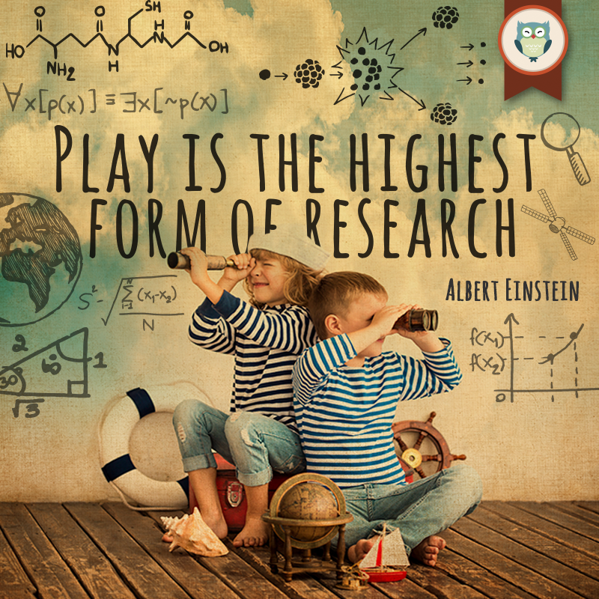

Slide 24
Positive Behavior Supports
Problem- Solving Model
Evaluate
Is the solution feasible?
Goal and Problem ID
Establish goals
Problem
Analysis
Why is the problem happening?
Intervene
Goal setting
Strengths and challenges
What’s the problem?
Integrity supports
Progress monitoring
Is the solution working?
Key Principles
*Collaborative
Data-driven
Non-linear
Adaptive to needs
Data collected
Breadth of info
Number of problems
Length of plan
Rigor of oversight
Notes:
Marcia - How has EASTCONN supports build capacity and improve effectiveness

Slide 25
Positive Behavior Supports
Practices & Principles
Antecedent
Behavior
Consequence
Foundational principles of behavior:
          Most behaviors are learned methods for communication
          Behavior can be “triggered” by events that happen before the behavior
          The chances of behavior being repeated depends on what happens after the behavior
Behavior intervention plans should be positive, proactive, educative, and functional
Notes:
Marcia

Slide 26
Contact Information
Steven Rioux, KPS Superintendent srioux@killinglyshools.org
Sally Sherman, GECC Director sherman@killinglyschools.org
Emily Caviggia, KCS Principal ecaviggia@killinglyschools.org
Marcia Griffiths-Farquhar, PSS Assistant Director, mgriffths@killinglyschools.org
Heidi Auclair-Golden, Instructional Coach, hgolden@killinglyschools.org

